Slide 1
State of the Baltic Sea 2023
Third HELCOM holistic assessment 2016-2021

Slide 2

Running order
About HOLAS
Results summary
Next steps

Slide 3
About HOLAS

Slide 4
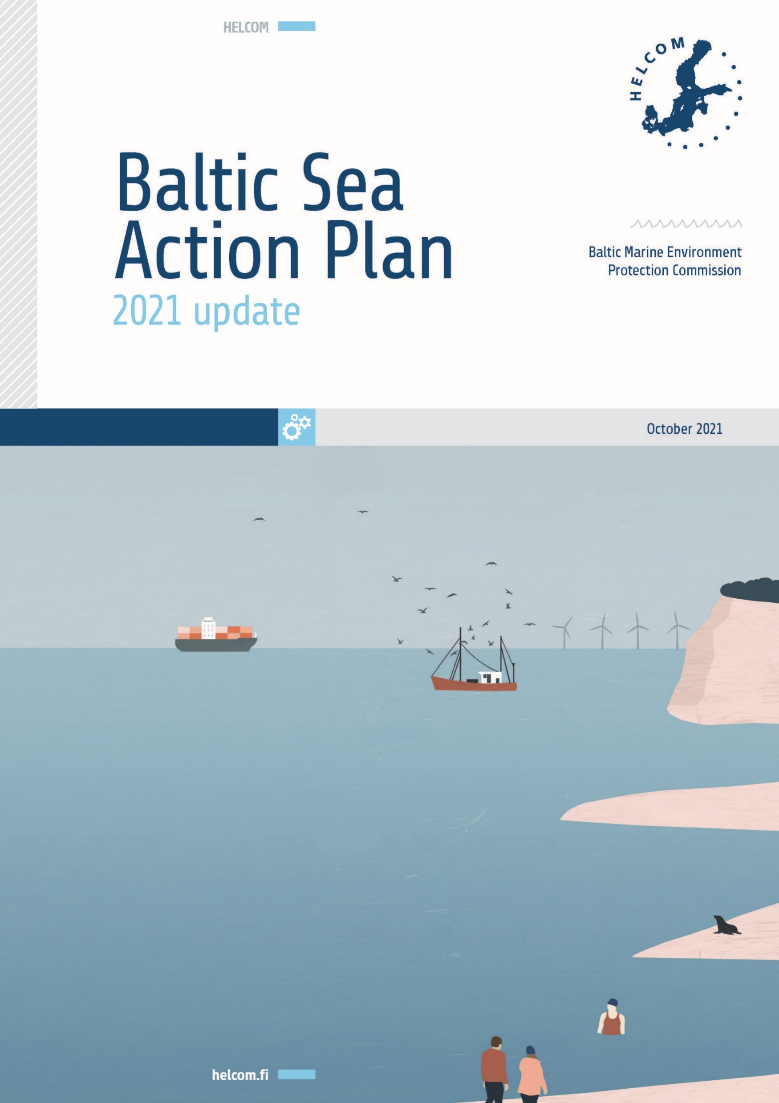
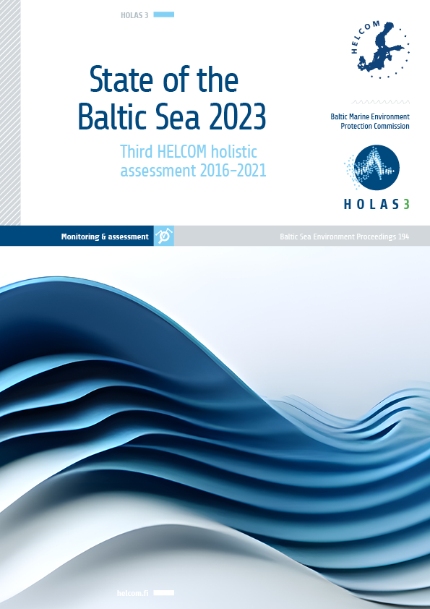
What is the State of the Baltic Sea report?
The 2021 HELCOM Baltic Sea Action Plan (BSAP) includes measures that HELCOM countries have agreed on to halt the deterioration of the Baltic Sea environment.
HELCOM carries out holistic assessments every six years to follow up on how well the measures are functioning.
The third HELCOM holistic assessment (HOLAS 3) focuses on the years 2016-2021.
The State of the Baltic Sea (2023) is synthesis report based on a wide range of assessment products produced within HOLAS 3.
Notes:
The 2021 HELCOM Baltic Sea Action Plan (BSAP) includes measures that HELCOM countries have agreed on as highly important to halt the deterioration of the Baltic Sea environment.
HELCOM carries out holistic assessments every six years to follow up on how well the agreement is functioning, focusing on how the Baltic Sea ecosystem is doing. These holistic assessments involve several hundred experts on a wide range of topics, from monitoring to system-level evaluations.
The third HELCOM holistic assessment (HOLAS 3) focuses on the years 2016-2021 and includes results at various levels of detail, including monitoring data, indicator reports and thematic assessments.
State of the Baltic Sea (2023) builds on, and integrates, results from a wide range of assessment products produced within the third HELCOM holistic assessment (HOLAS 3).

Slide 5
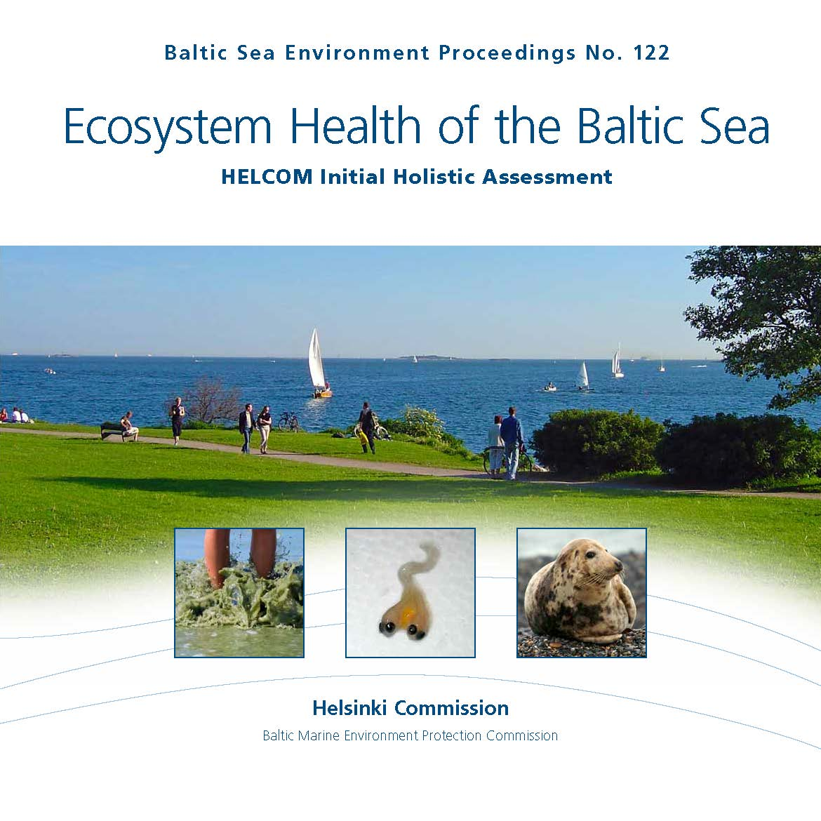
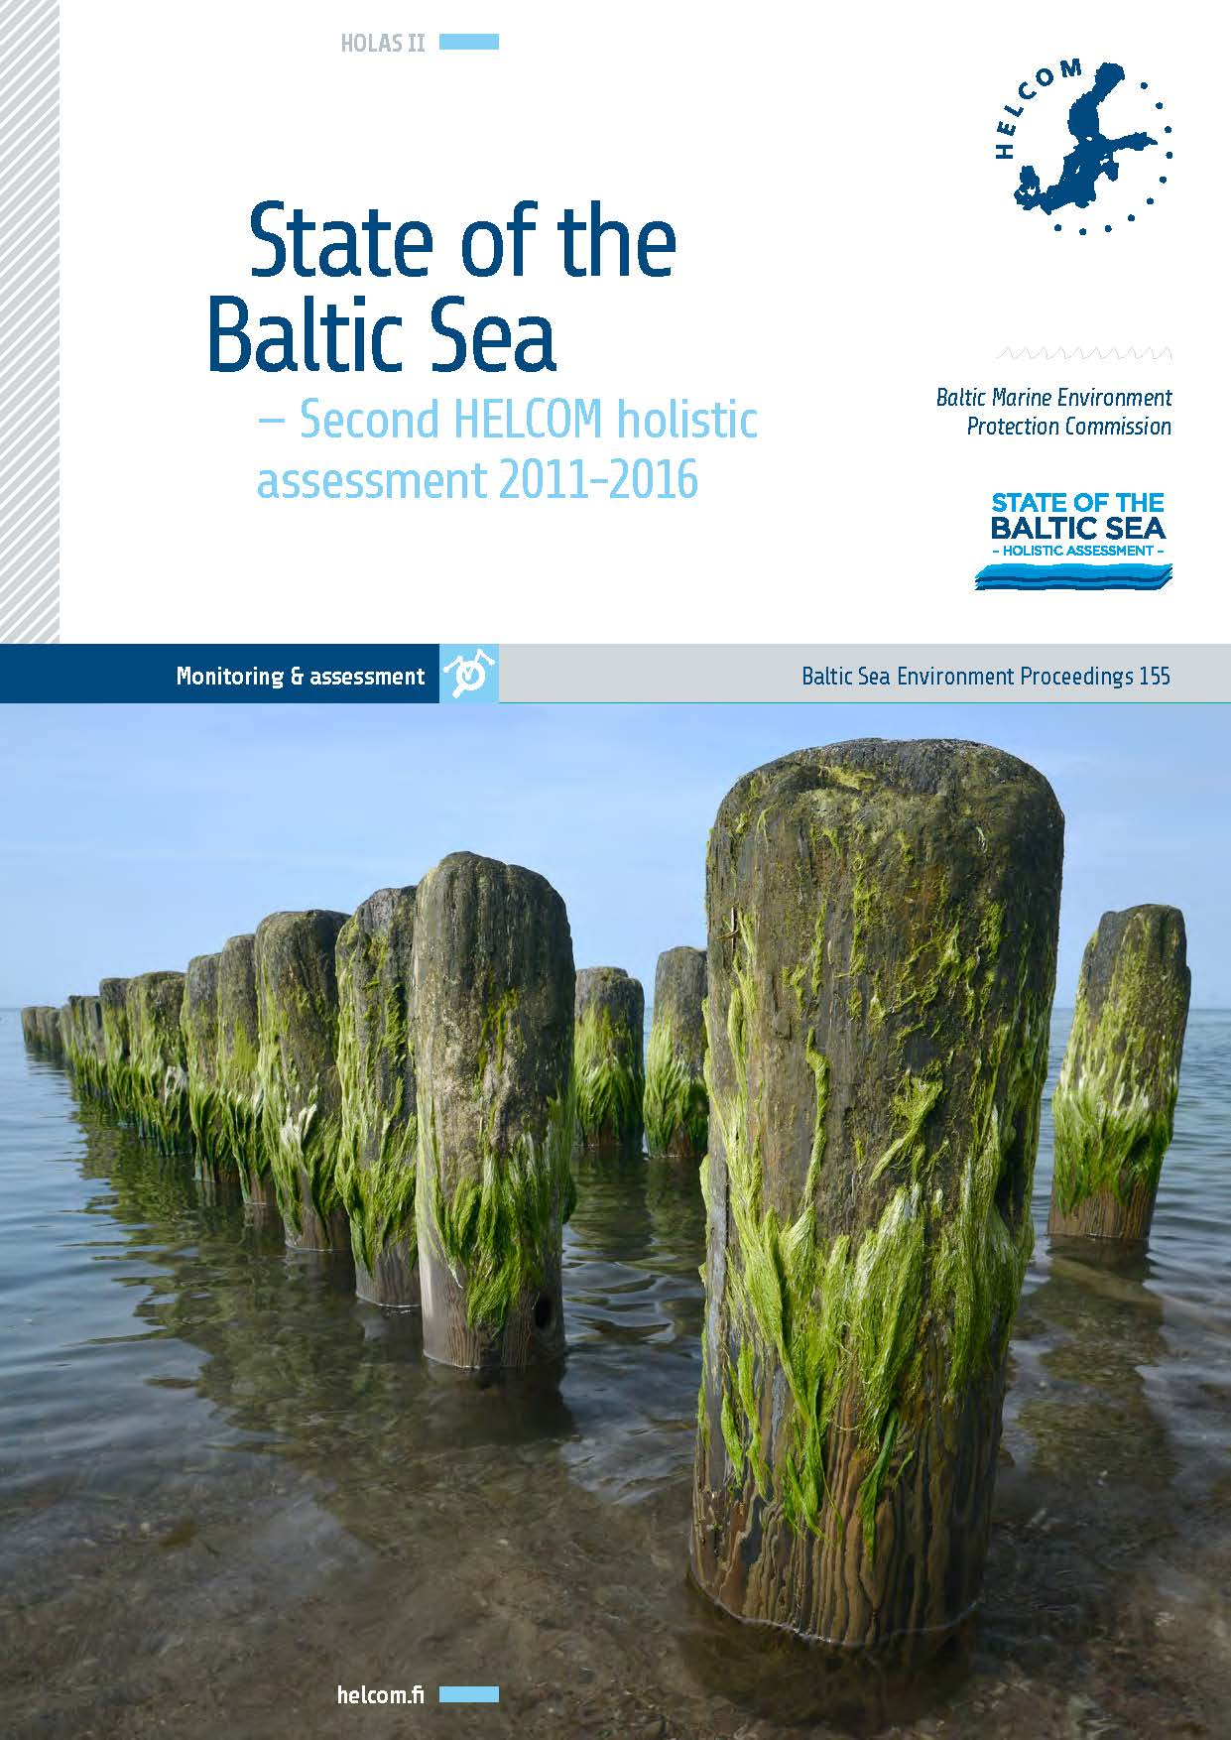
HOLAS timeline
Second HELCOM holistic assessment 2011-2016
(HOLAS II)
Third HELCOM holistic assessment 2016-2021
(HOLAS 3)
Initial holistic assessment 2003-2007
2010
2018
2023

Slide 6






HOLAS provides decision-makers and authorities with…
Information on the status of the Baltic Sea environment
Information on the spatial variation of status
Information trends in development over time
Informs on the distribution of pressures and human activities
Follow up on the effect of our measures
Data for EU MSFD reporting
Notes:
The measures of the Baltic Sea Action Plan also support several other environmental commitments of the Baltic Sea countries, including the United Nations Sustainable Development Goals. The holistic assessment also helps EU countries within HELCOM meet the requirements for coordinated reporting under the EU Marine Strategy Framework Directive.

Slide 7
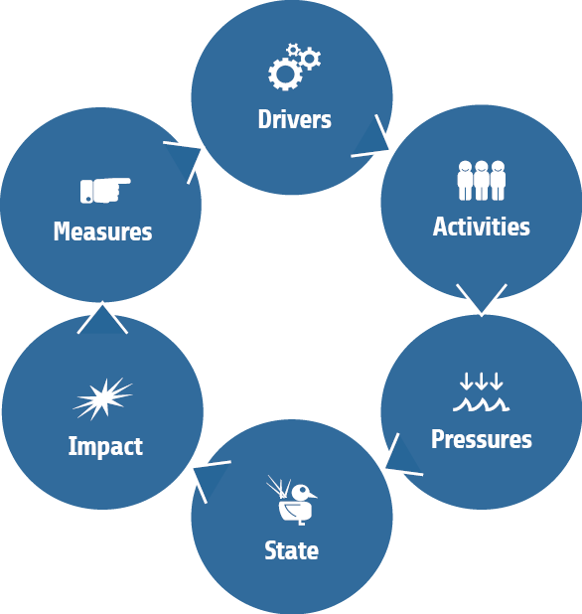
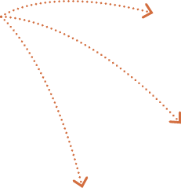
DAPSIM framework

Slide 8
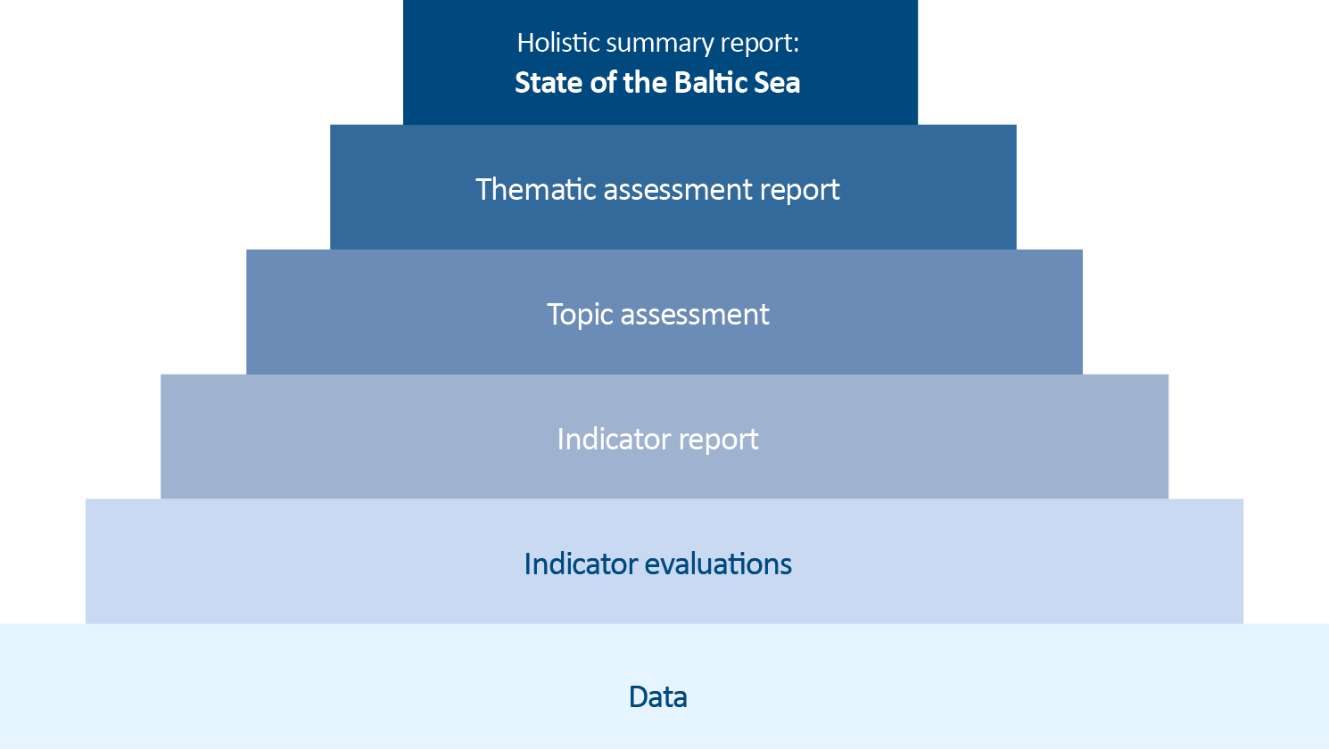
HOLAS products

Slide 9
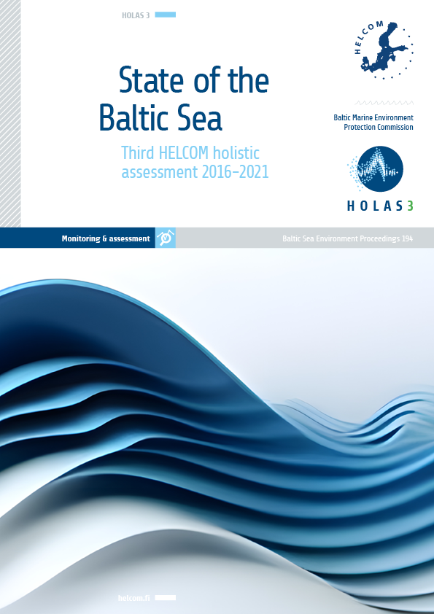
HOLAS 3 timeline
Publication phase
Thematic assessments
Indicator reports
State of the Baltic Sea report
Assessment phase
Approval of data
Approval of indicator reports
Approval of thematic assessments
Approval of summary report ‘State of the Baltic Sea’
Data collection phase
Development phase
2019
2020
2021
2022
2023

Slide 10
HOLAS in numbers
956
Experts invited in the review process
5
Thematic assessments
2956
Comments addressed
59
Indicators
290
New maps
3488
Pages of reports
156,940
Cups of caffeinated beverages consumed
2,000,000+
Data points

Slide 11
Results summary

Slide 12


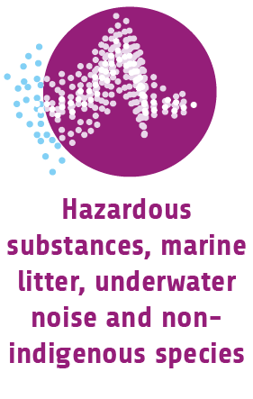


Five themes of the assessments

Slide 13





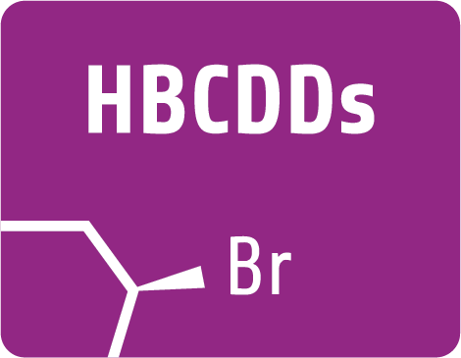

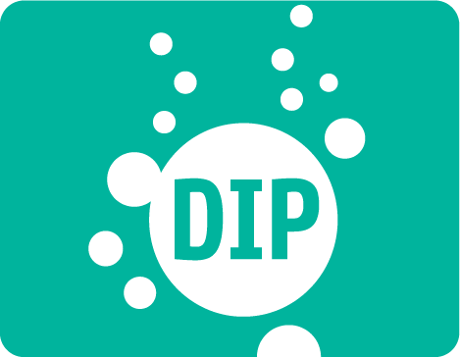

















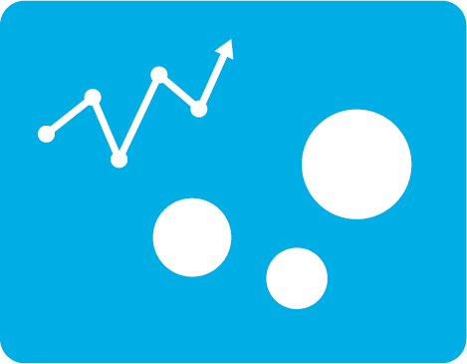




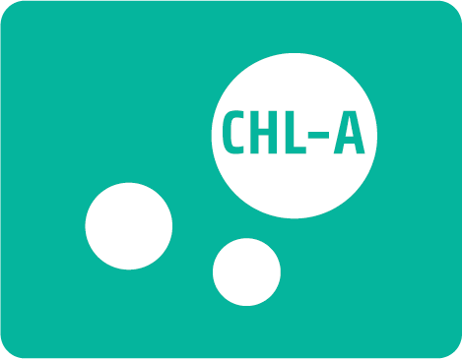






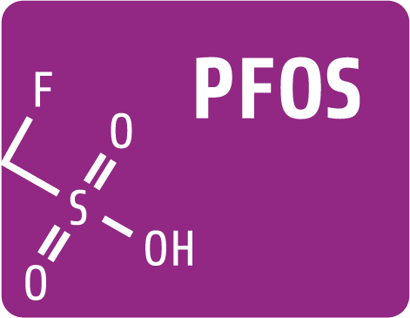



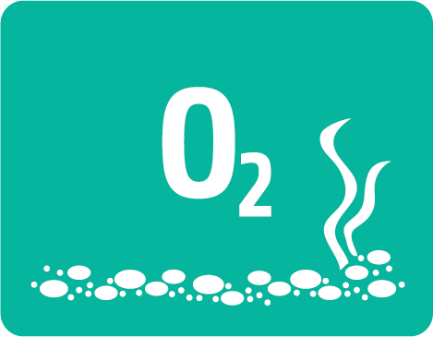







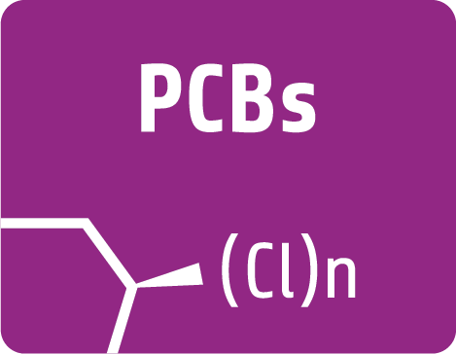

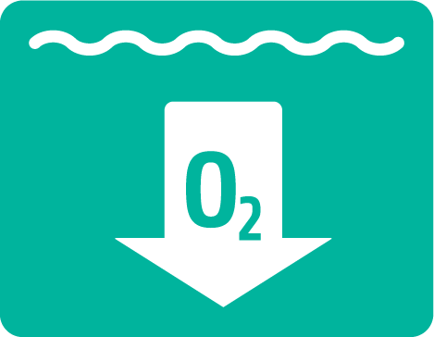




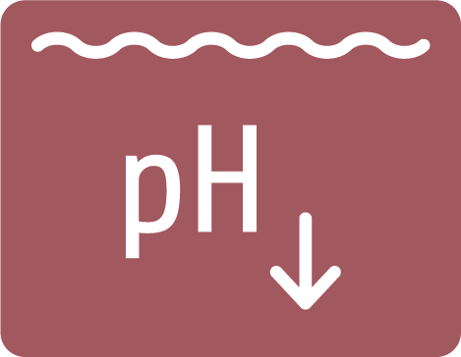
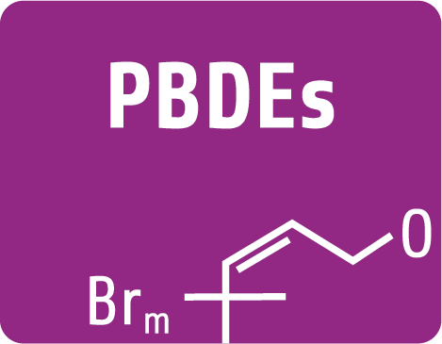
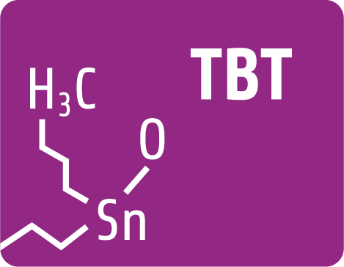
59 indicators (42 core, 11 pre-core, 1 supplementary, 1 element, 4 driver)

Slide 14

Thematic assessments by topic & sources of data
Pelagic habitats
Benthic habitats
Fish
Water-birds
Marine mammals
By-catch
Nutrient levels
Direct effects
Indirect effects
Under-
water
noise
28 Human activity datasets
17 Pressure layers
57 Ecosystem component layers
Use of marine waters
Cost of degradation
Ecosystem services
Cost-benefit analysis
Drivers
Marine litter
Hazardous substances
NIS
Other assessment methods used for:
Foodwebs
Threatened species
Threatened habitats & biotopes
Spatial protection
Restoration

Slide 15



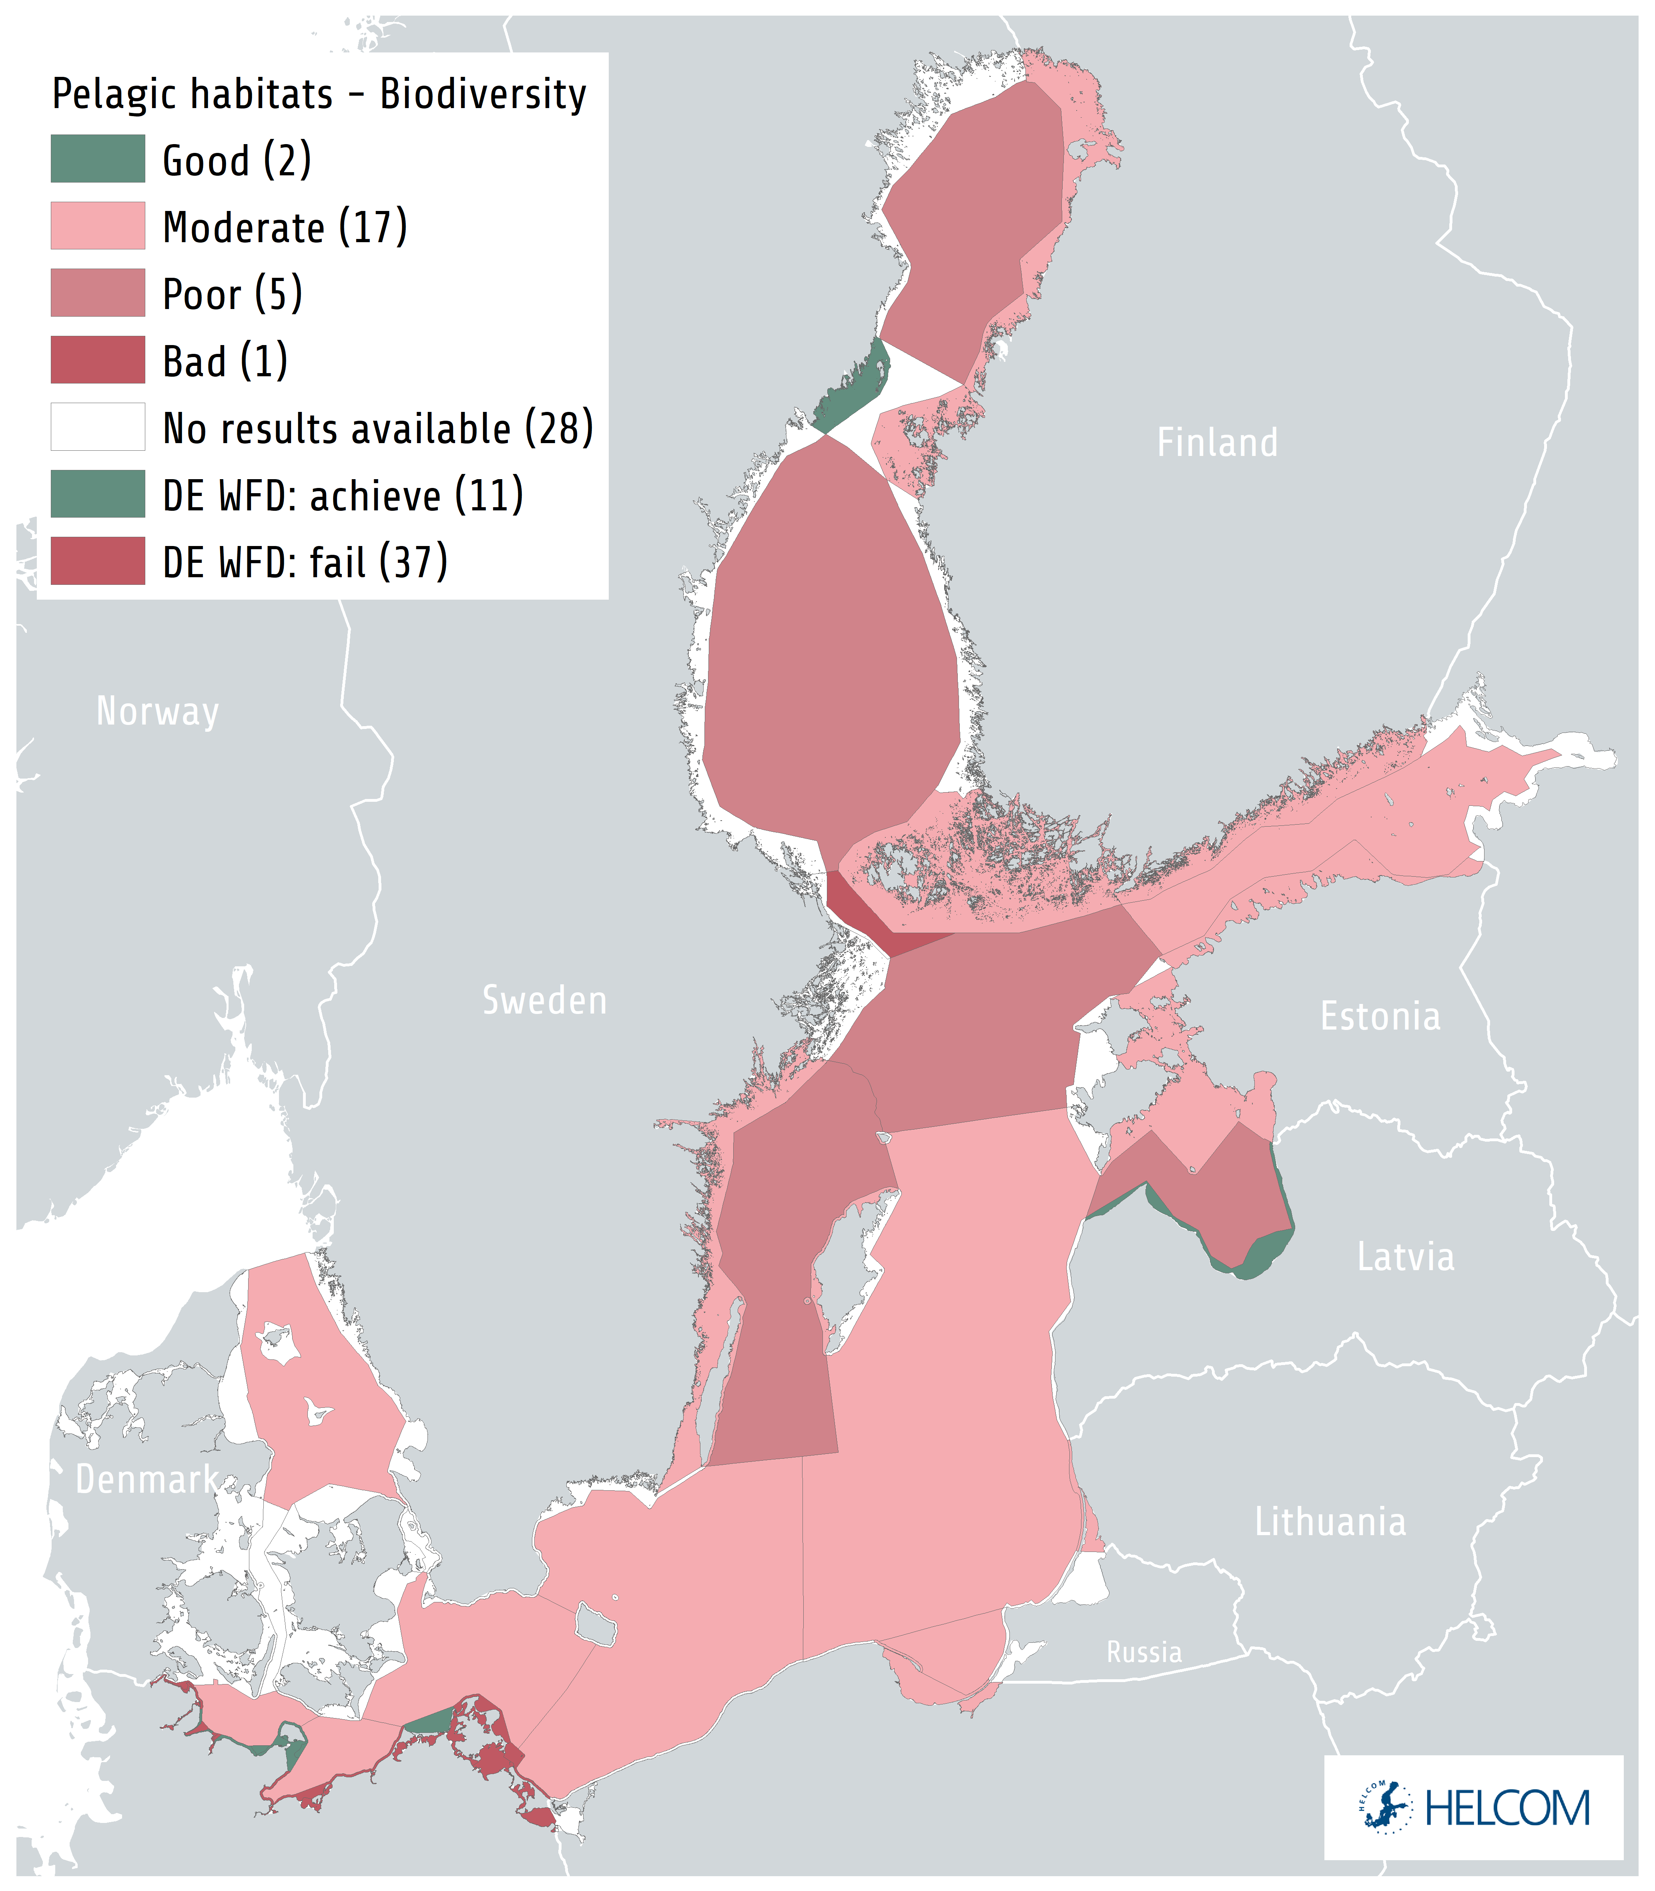
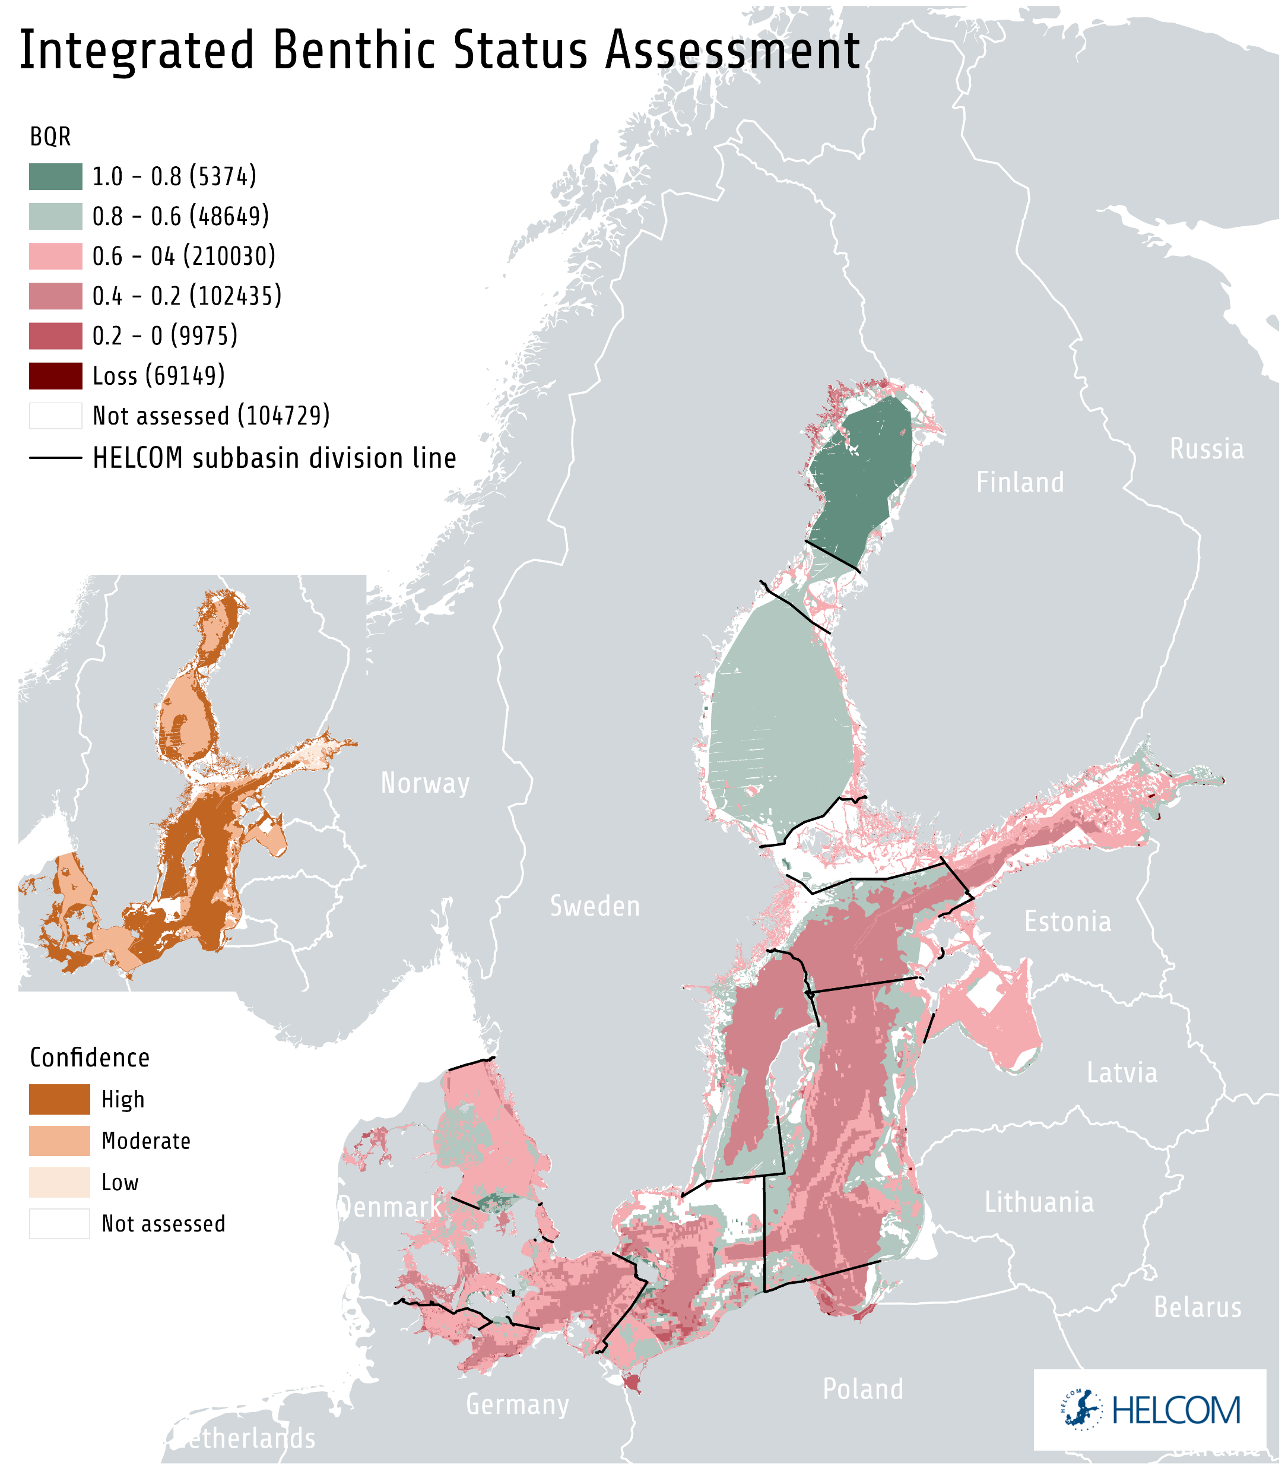
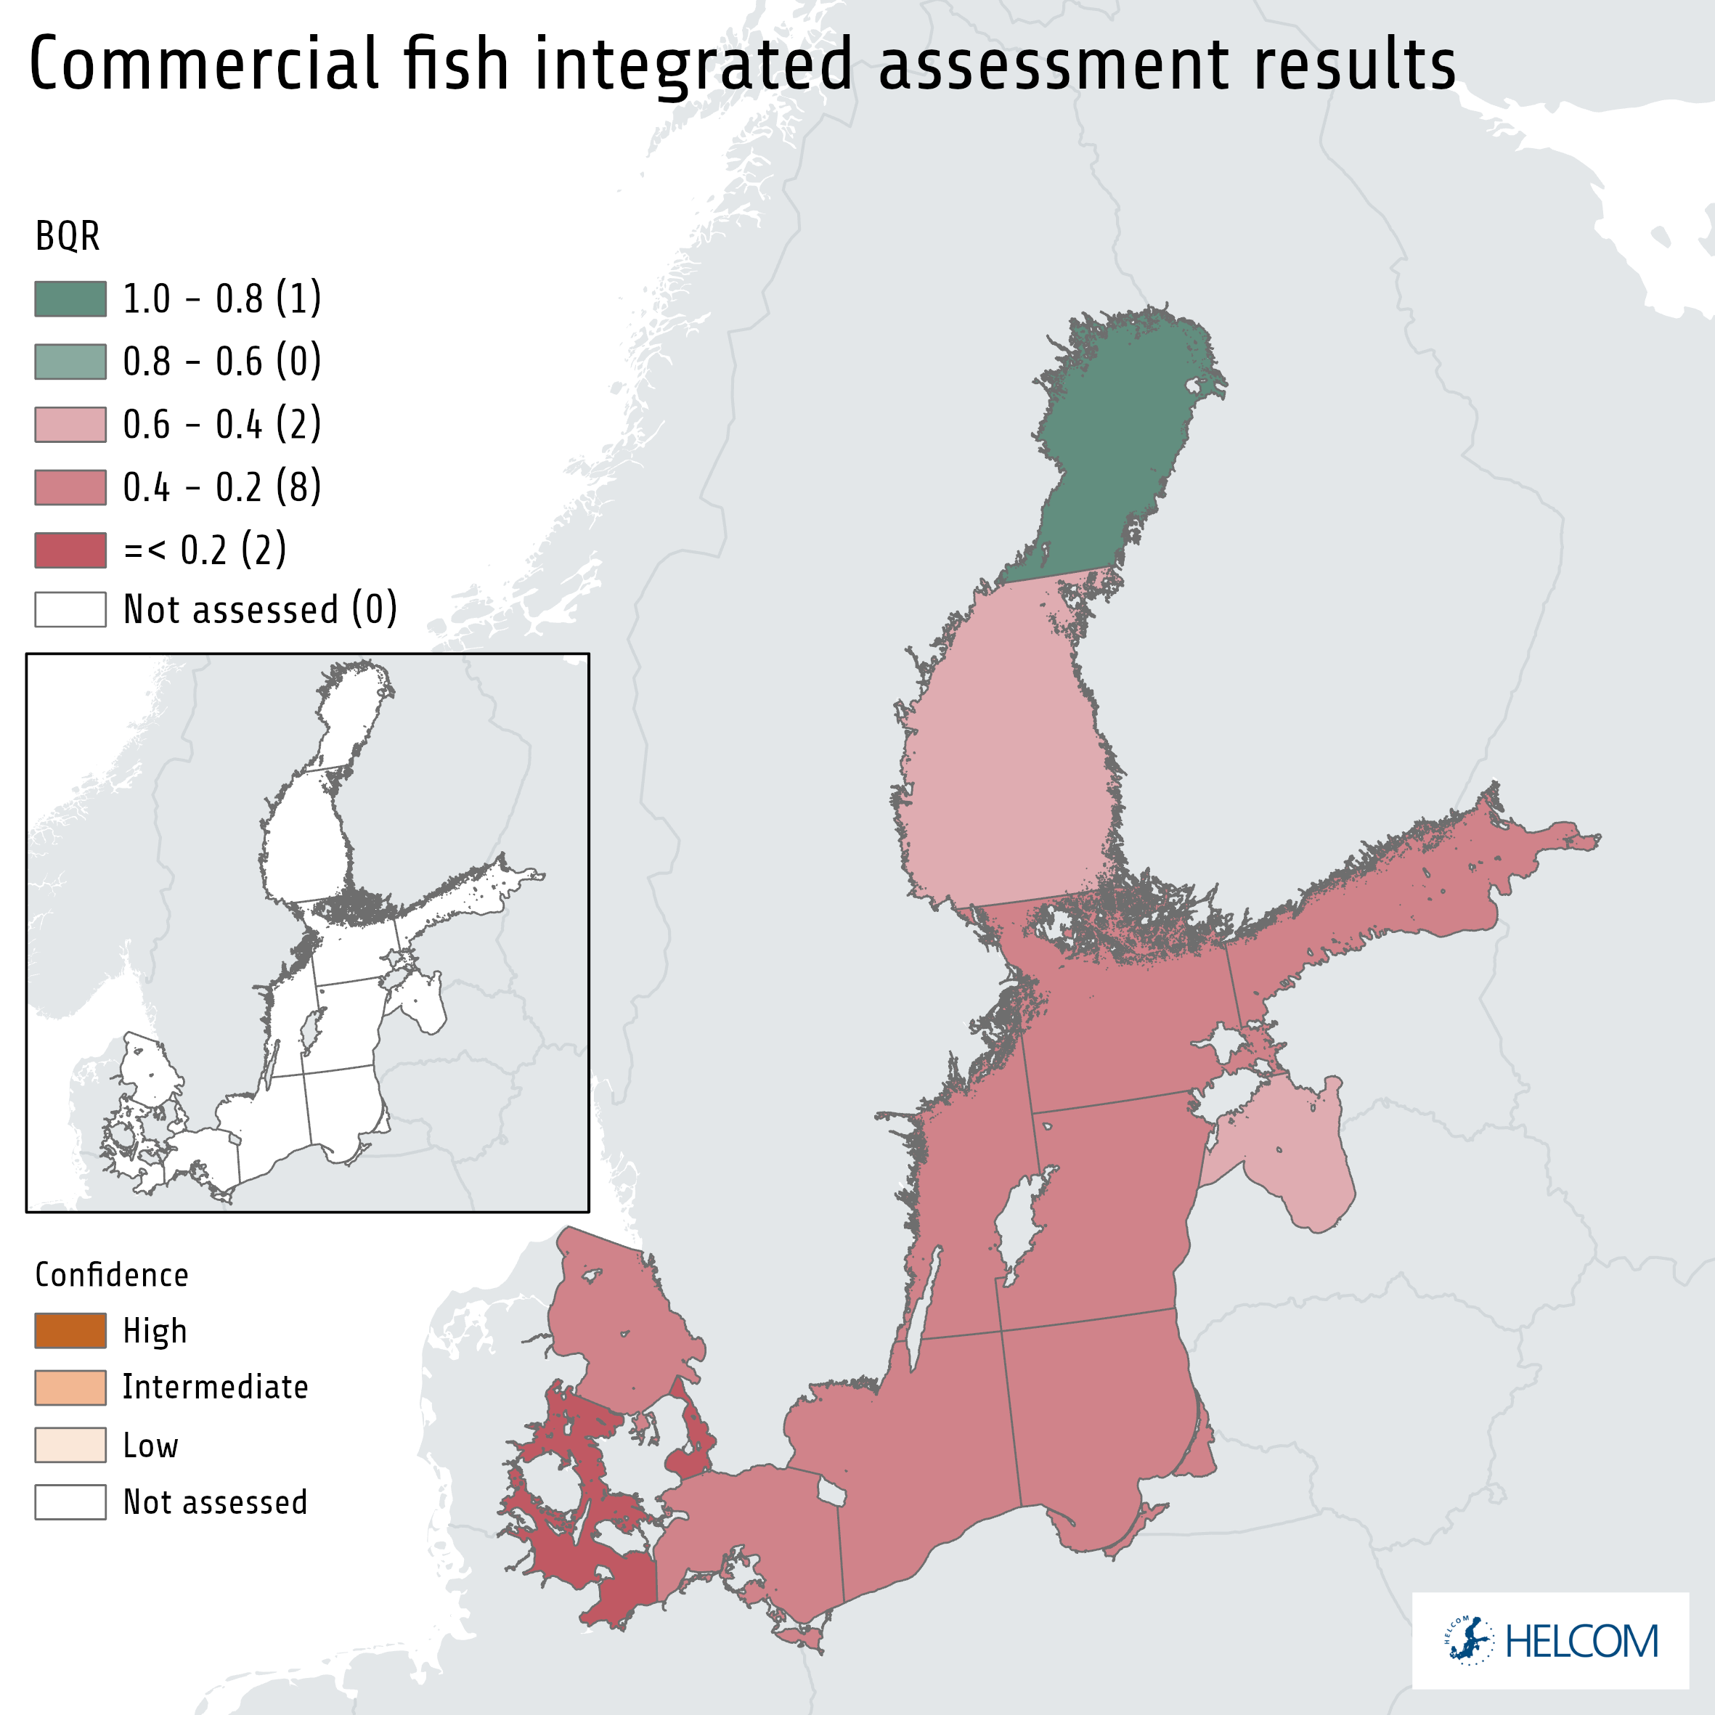
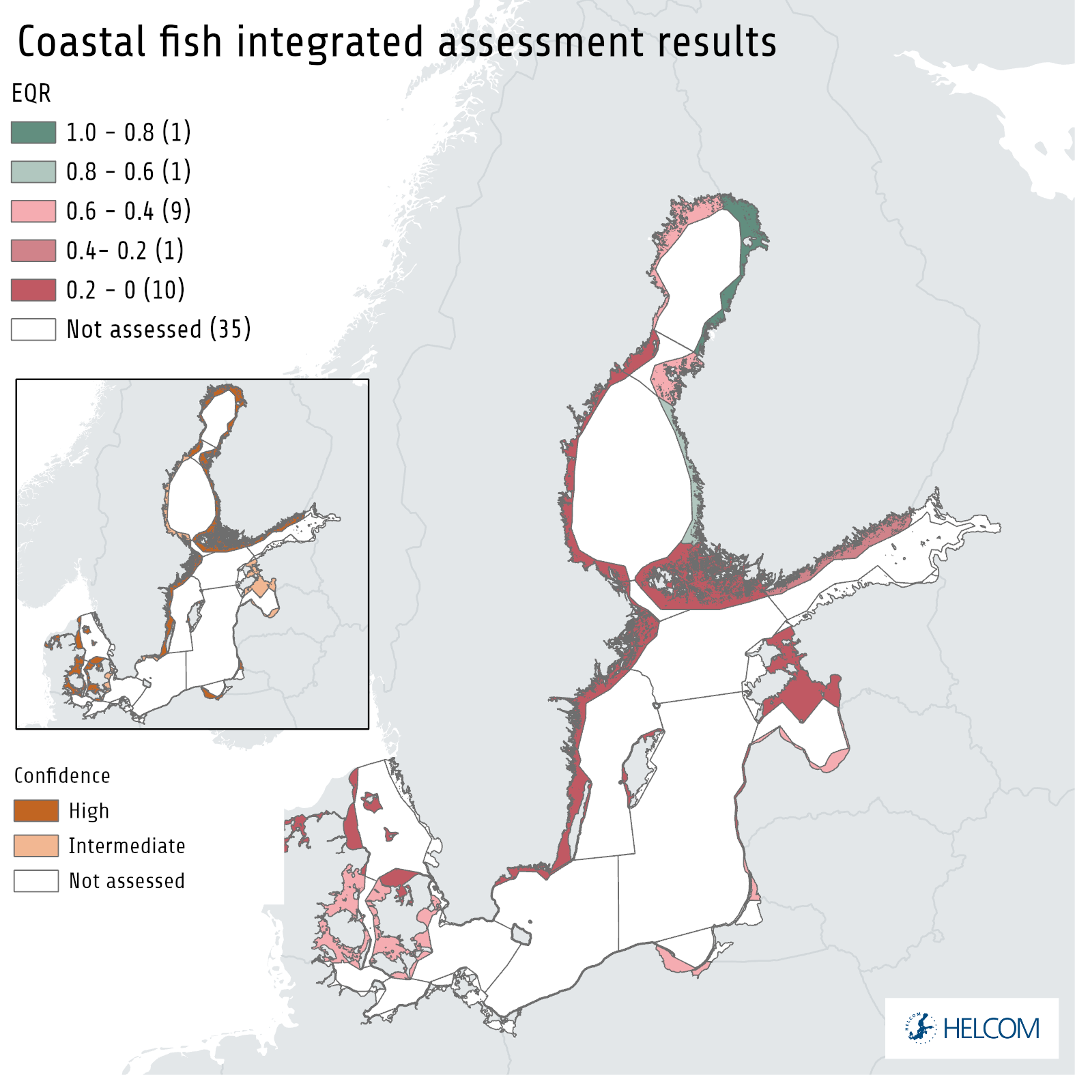

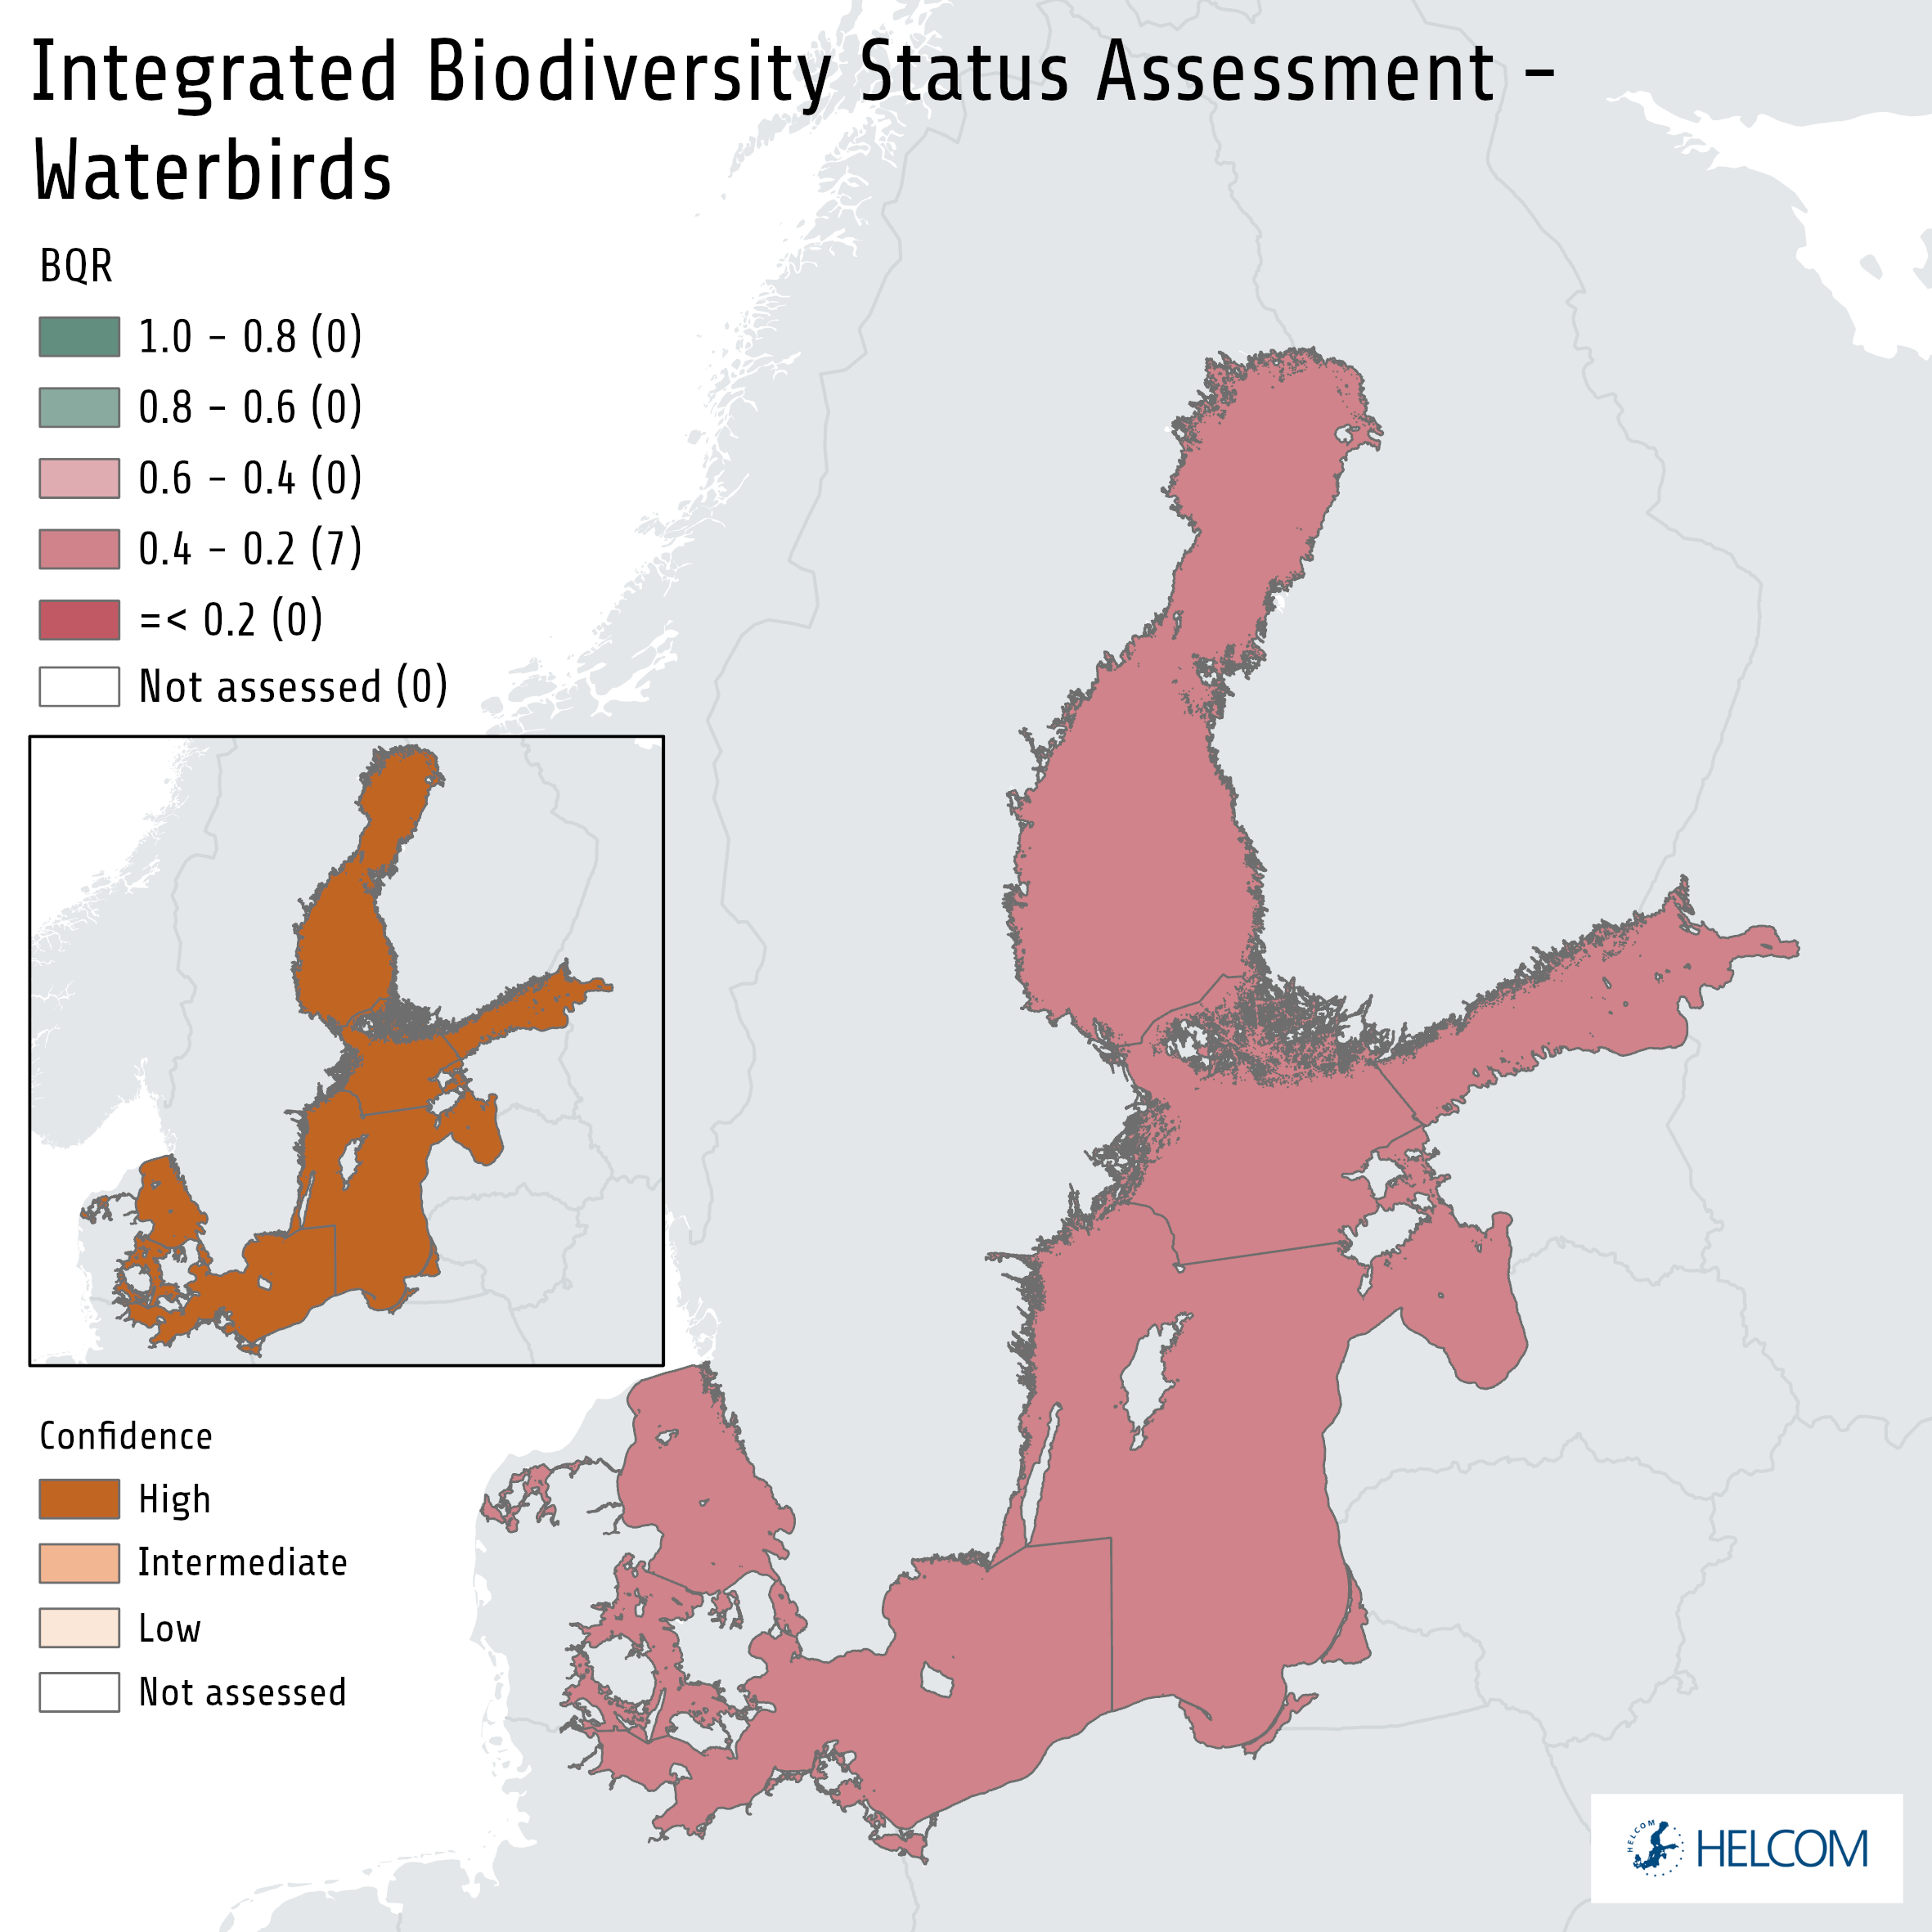

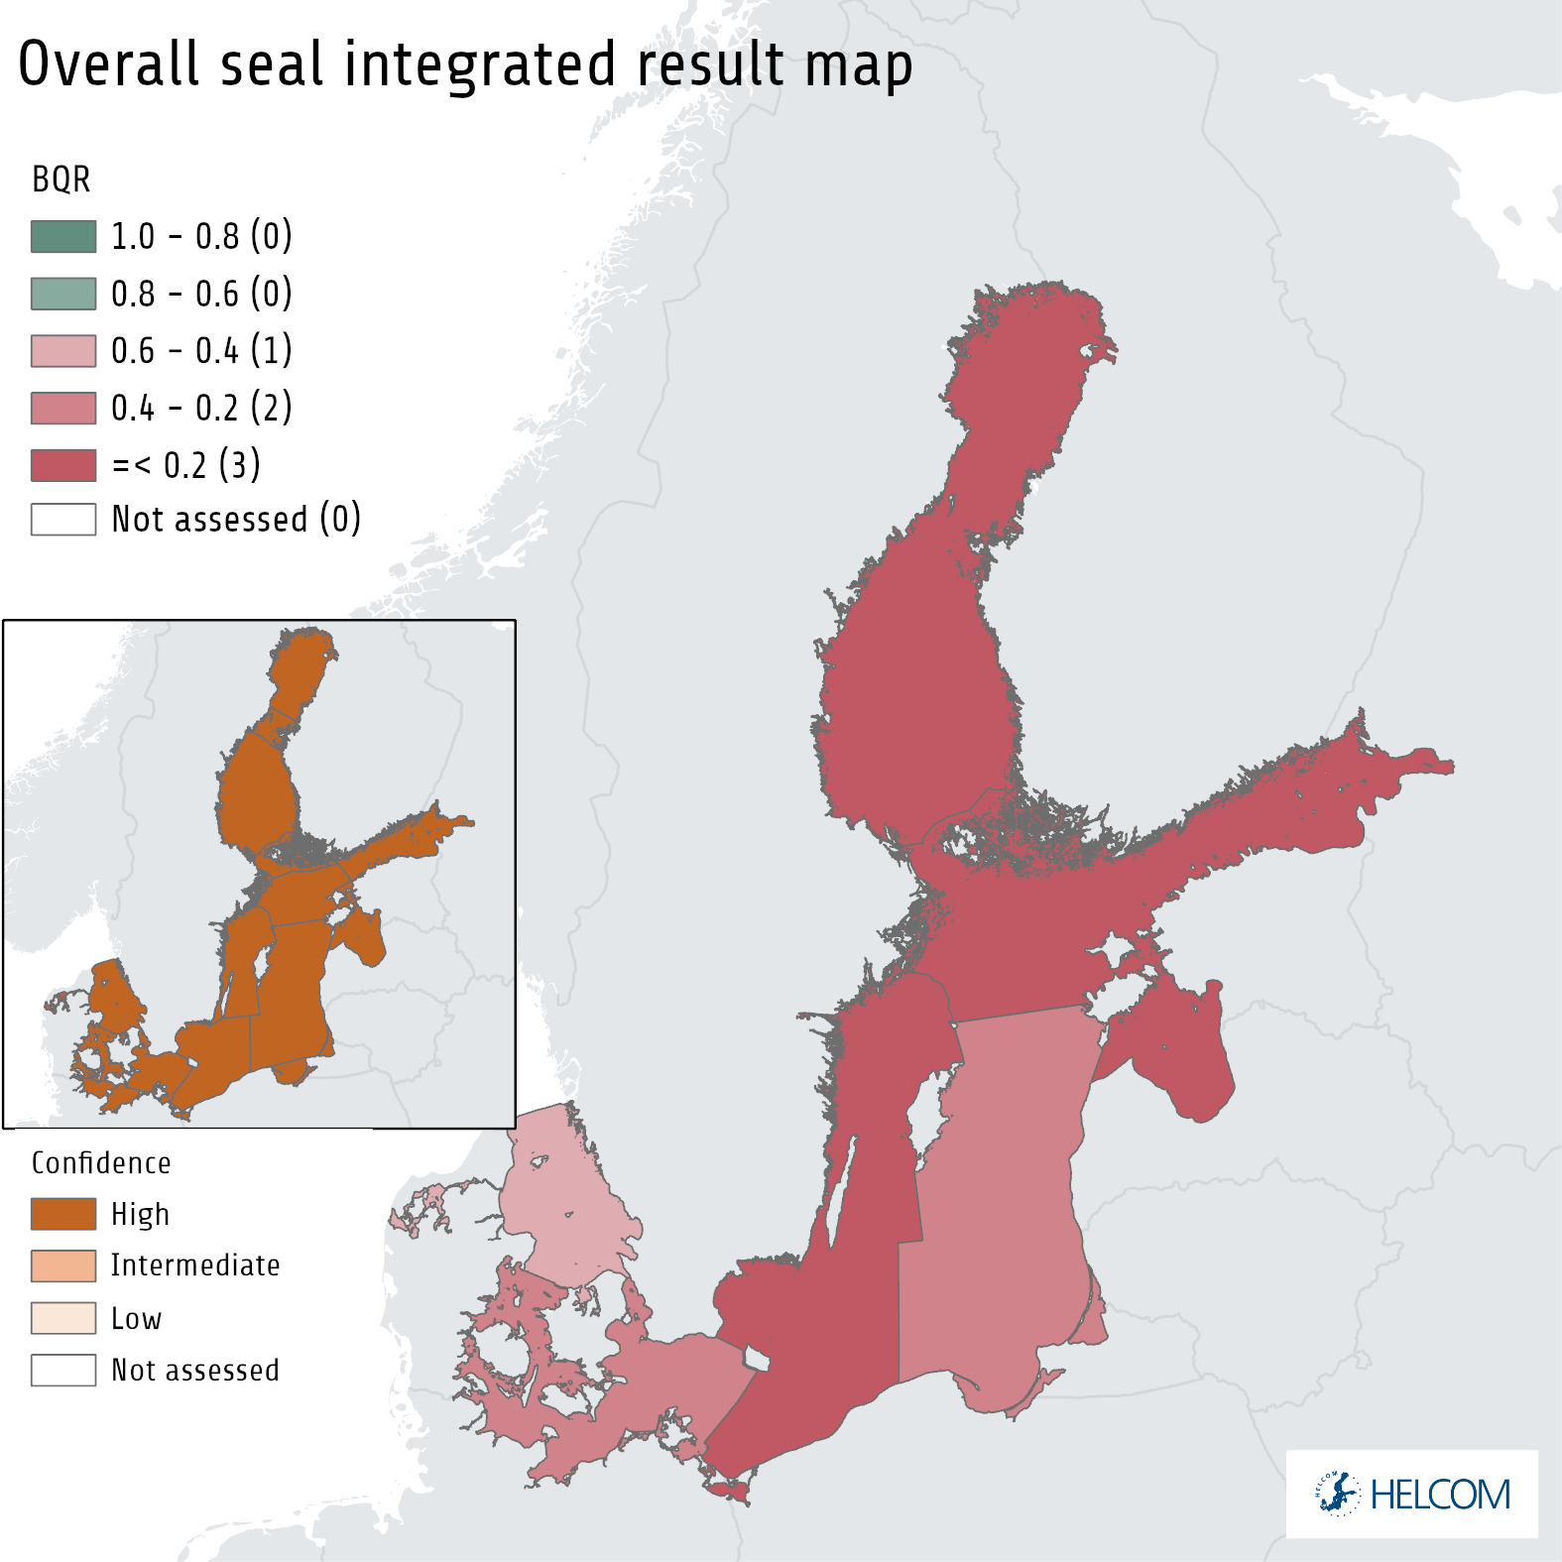
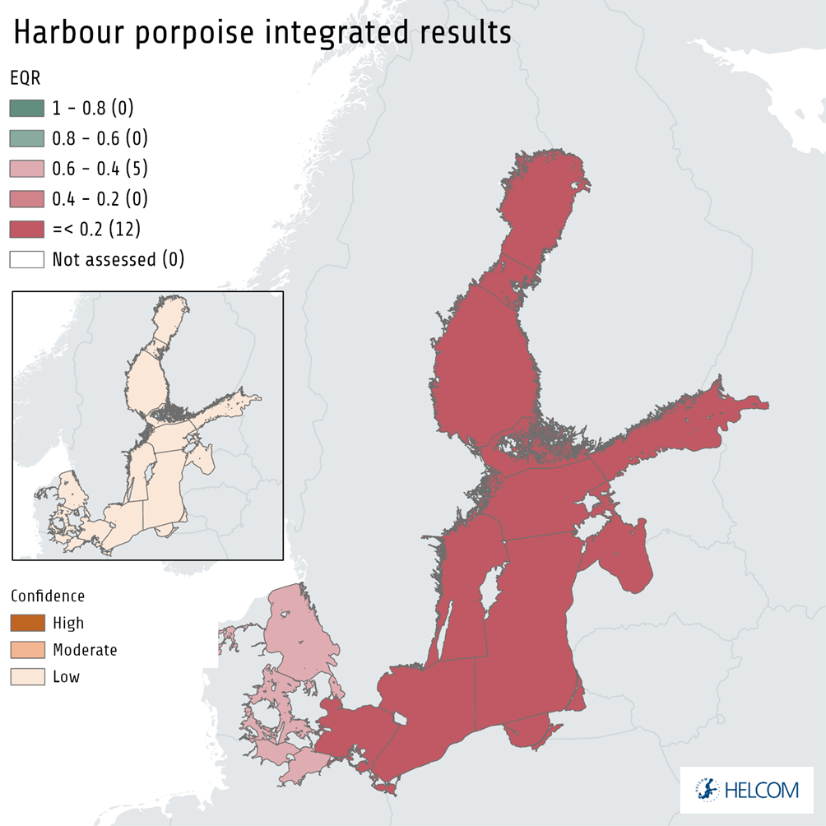
Biodiversity - Key takeaways
Pelagic habitats
Benthic habitats
Fish
Waterbirds
Marine mammals
Notes:
The results clearly show the need of continued and improved coordinated measures for the Baltic Sea environment.
For the HELCOM biodiversity indicators, there are cases of inadequate status across the full spatial extent of the Baltic Sea and in all levels of the food web.
Only a few core indicators have acceptable levels in parts of the region, and none in all assessed areas.
The deteriorated status is of immediate concern regarding the affected species or ecosystem components, but through the links within the food web, they also lead to impacts on the ecosystem as a whole.

Slide 16

Biodiversity – status by topic
Pelagic habitats do not have good status in any open sea subbasin
Benthic habitats generally do not have good status in the southern Baltic Sea, while their status is good in open sea areas in the northernmost subbasins.
For fish, only 4/15 assessed commercial stocks have good status.
Waterbirds generally do not have good status.
Marine mammals exhibit not good status in the
Baltic Sea.
Food webs: Major changes in the abundance and biomass of species, driven by human pressures, have been associated with changes in the food webs of the Baltic Sea.
Notes:
Pelagic habitats, including phytoplankton and zooplankton, do not have good status in any open sea subbasin. 4/13 assessed coastal areas have good status for phytoplankton. When eutrophication indicators are also included in the assessment, no open sea or coastal pelagic habitats have good integrated status.
Benthic habitats generally do not have good status in the southern Baltic Sea, while their status is good in open sea areas in the northernmost subbasins. Oxygen conditions are worsening. The oxygen debt below the halocline is increasing in all basins, especially in the Baltic Proper, and the increase between the previous and current assessment periods was very steep. Most coastal areas do not have good status.
For fish, only 4/15 assessed commercial stocks have good status. The status has declined for three stocks, improved for one and remained unchanged for eight stocks that were also assessed in the previous assessment period. The integrated status of coastal fish is good in only two of the twenty-two assessed areas, representing a worsened situation.
Waterbirds do generally not have good status, although there is variability between groups with different feeding behaviours.
Marine mammals are represented by four species in the Baltic Sea. Grey seals and harbour seals are increasing in some areas, but the indicators for population growth rates, as well as reproductive and nutritional status, do not reach threshold values. Behavioural change in the ringed seal, possibly explained by a warming climate, has impaired the quality of monitoring data to evaluate its status in the Bothnian Bay. The status of the harbour porpoise is not good.
Food web assessments address the species interactions and energy flows that support ecosystem health. Major changes in the abundance and biomass of species, driven by human pressures, have been associated with changes in the food webs of the Baltic Sea in recent times, and several examples of food web disruptions and putative tipping points are a cause for concern.

Slide 17
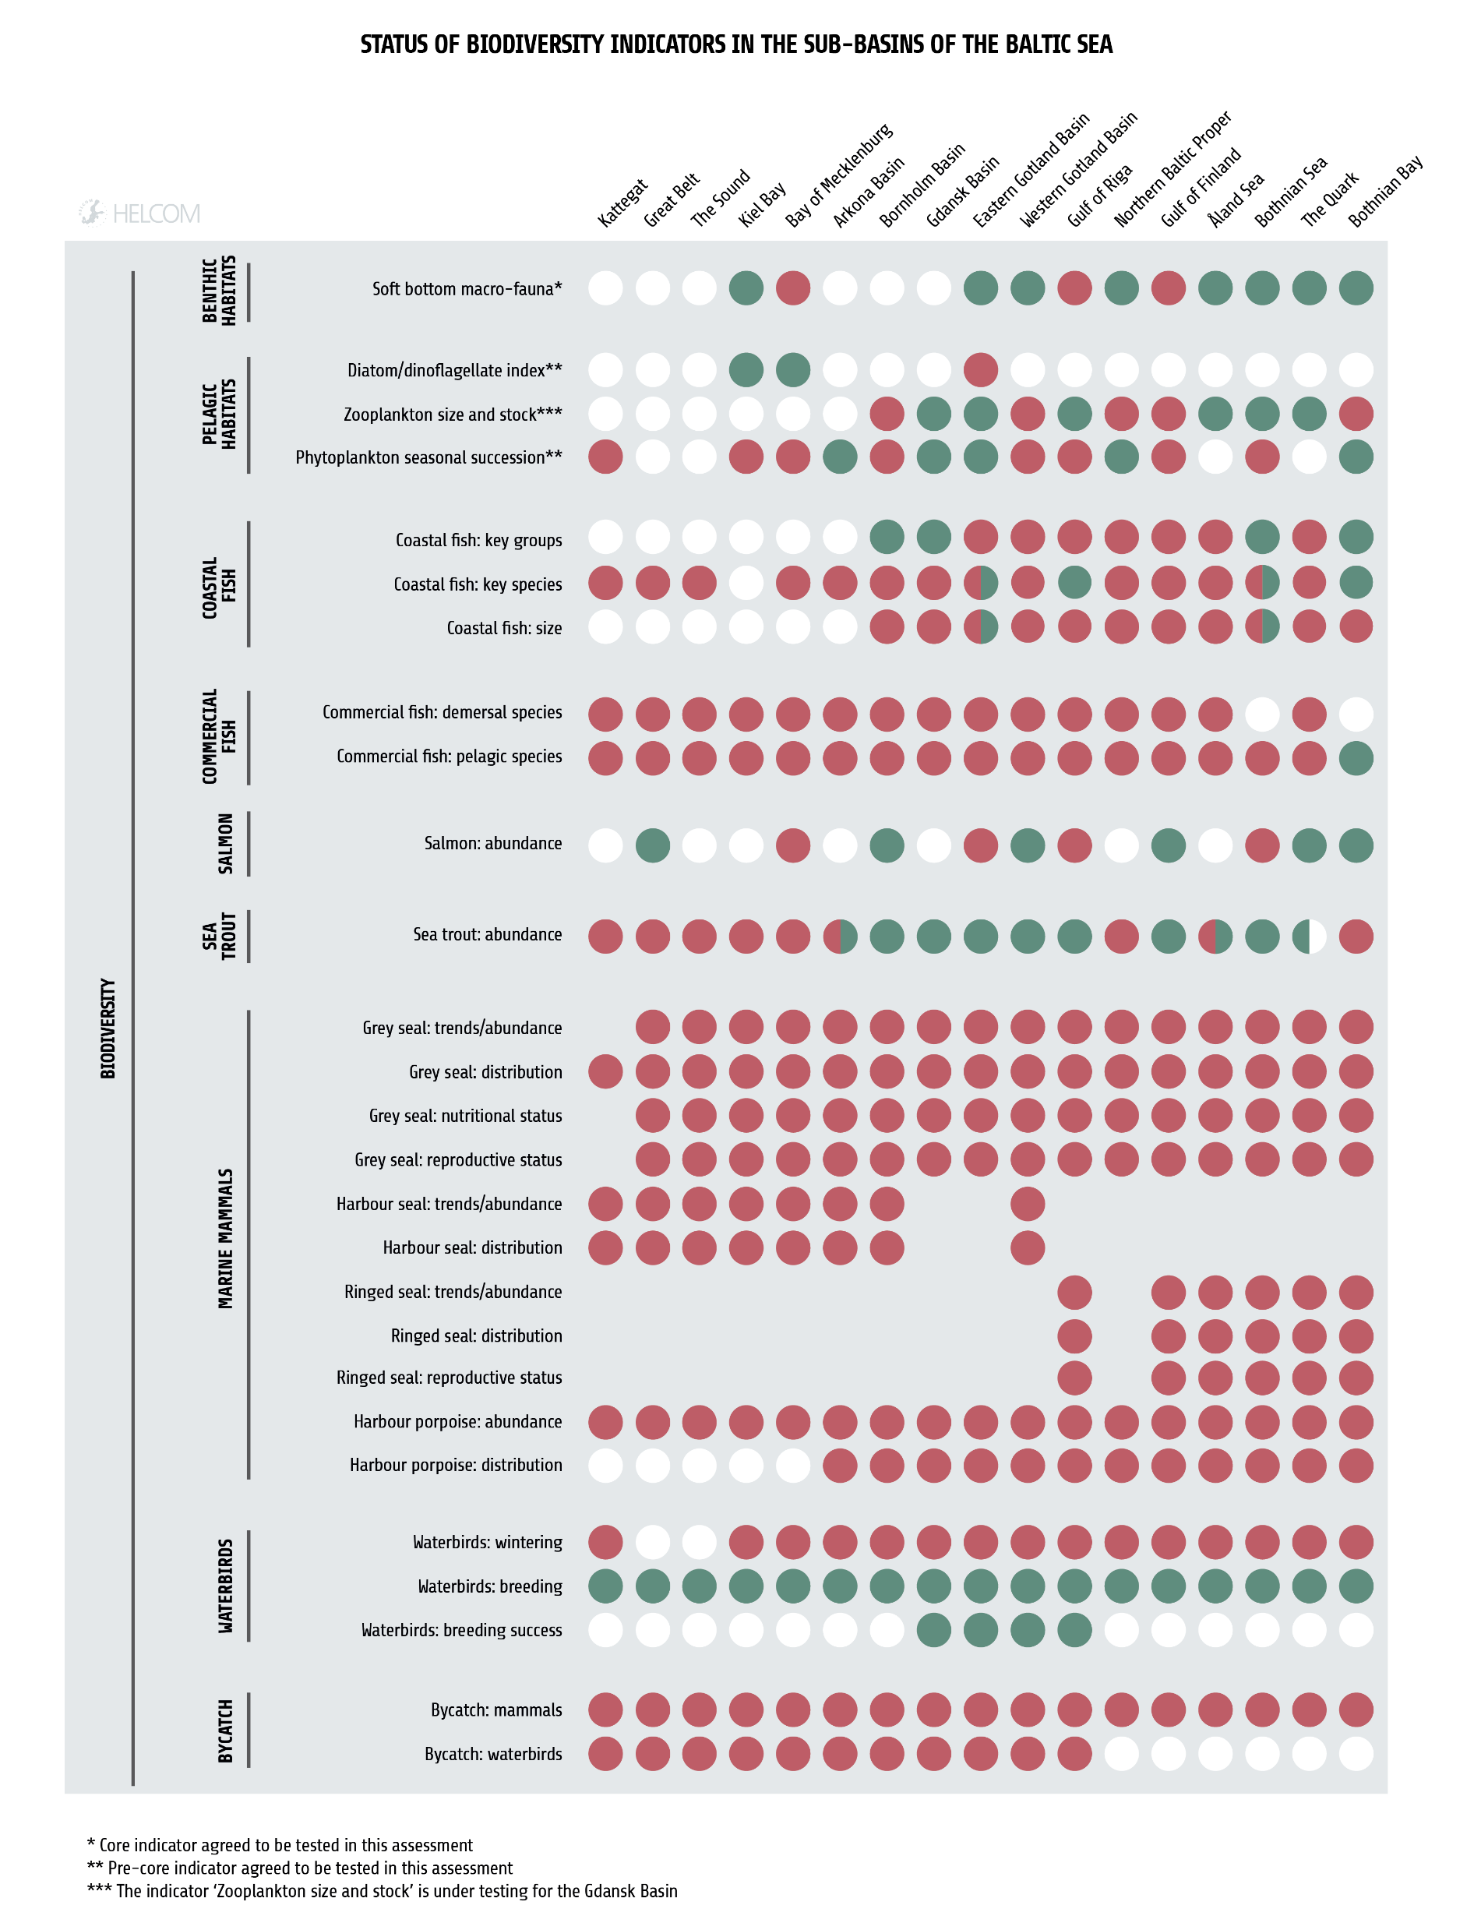
Status of biodiversity core indicators by sub-basin
Notes:
Status of biodiversity core indicators by sub-basin. Green circles indicate good status, red circles indicate not good status. White circles indicate that the core indicator is applicable for the sub-basin, but has not been evaluated. Empty points indicate that the indicator is not applicable. For coastal indicators, pie charts show proportion of coastal assessment units per sub-basin in good status (green), not good status (red) and not evaluated (white).

Slide 18
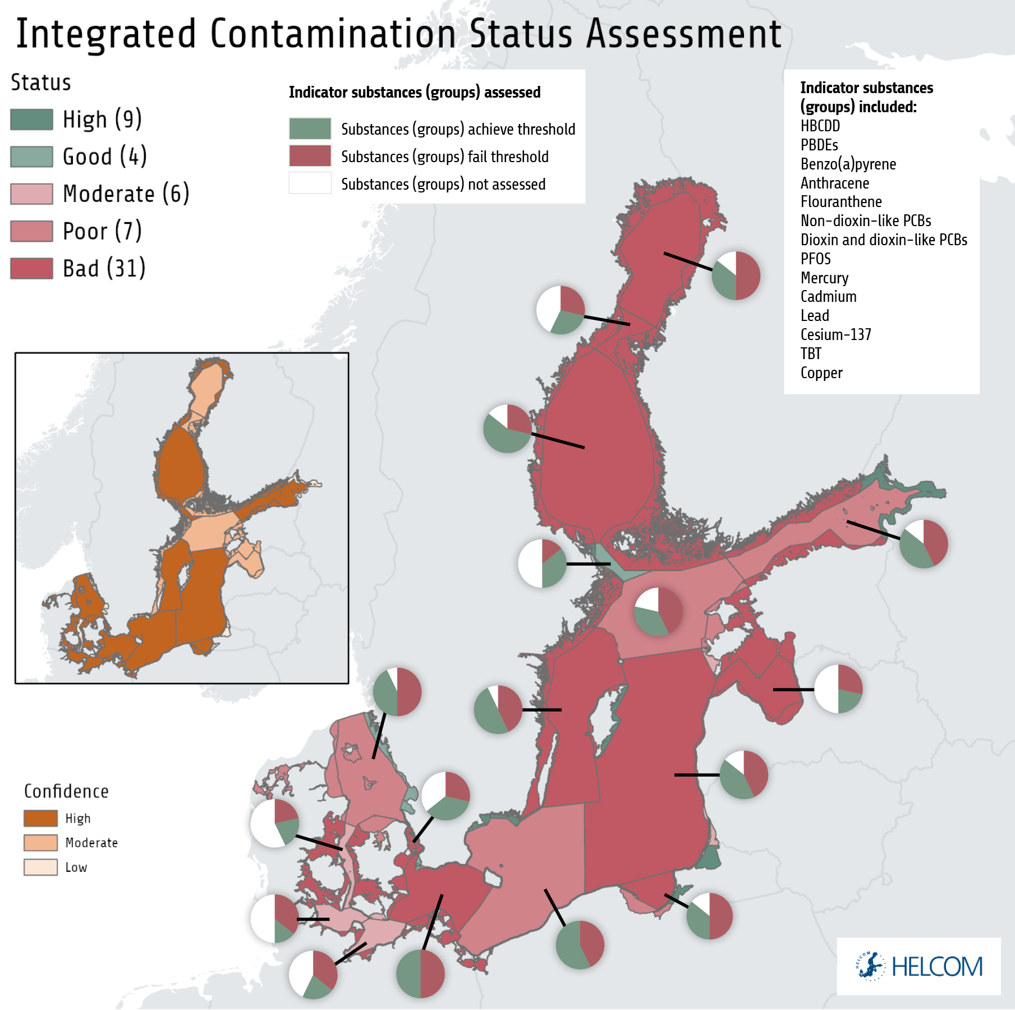
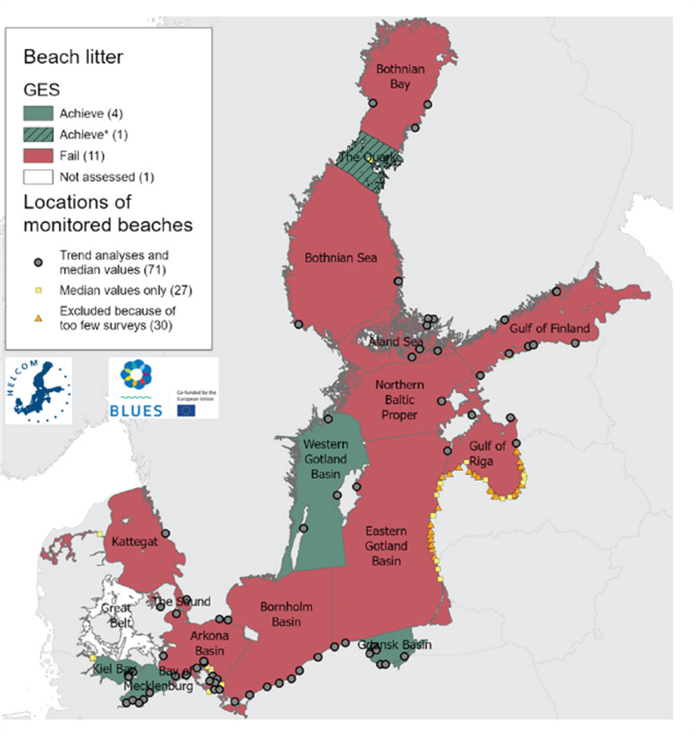
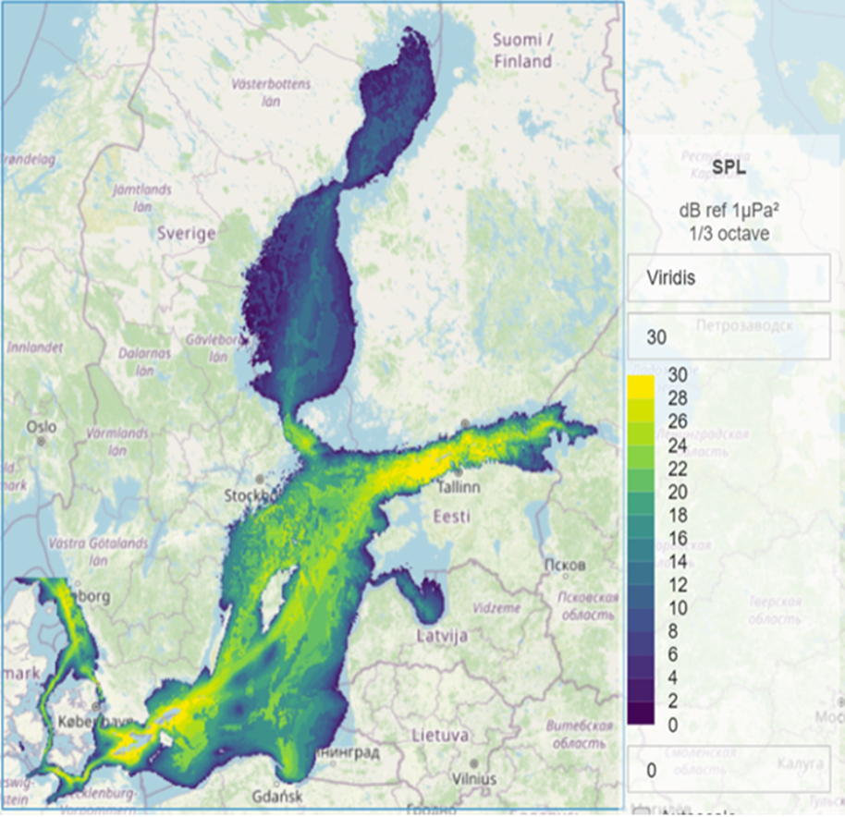
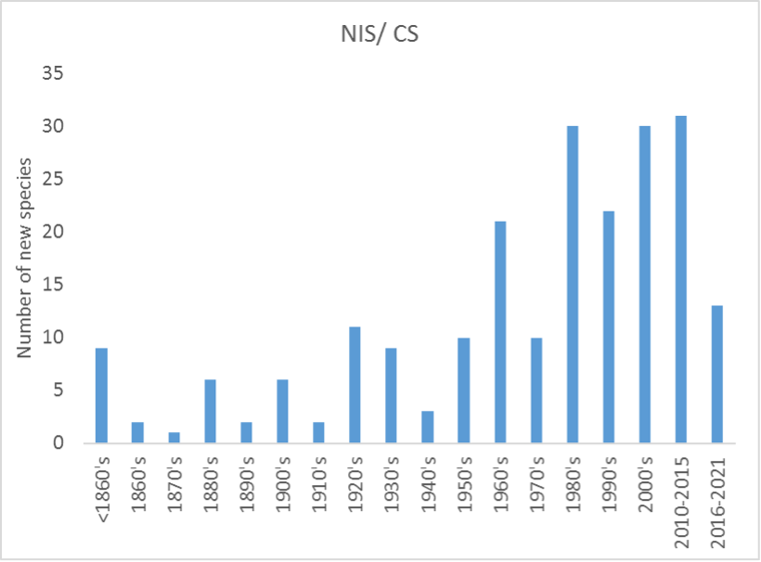
Hazardous substances, marine litter, underwater noise and non-indigenous species - Key takeaways
Hazardous substances
Marine litter
Underwater noise
Non-indigenous species
Notes:
Figure caption: The integrated assessment of hazardous substances status in the Baltic Sea, assessed using the CHASE integrated assessment tool. The assessment shows that hazardous substances are a cause for concern in almost all assessed units, and those showing good status generally lack a full and adequate assessment. The integrated assessment is based on 11 core indicators. It integrates concentrations to threshold-derived values (contamination ratios) for fourteen individual hazardous substances or substance groups. The overall assessment is moderated by a parallel assessment of confidence (see inset map on the left) that can be considered an appraisal of the data coverage and assessment quality in any given assessment unit.
Figure caption: Median excess level for third octave band 125 Hz in March 2018. The map represents the time of the year with the most favourable conditions for the transmission of anthropogenic noise in the Baltic Sea.
Figure caption: Number of new NIS in Baltic Sea until 2021 (data source AquaNIS). The bars indicate the number of new introduced species per time-period. Note that the latter period on the figure is not representative of equal time periods. The threshold value is 0 new introductions.

Slide 19
Hazardous substances, marine litter, underwater noise and non-indigenous species– status by topic
Marine litter
11/16 sub-basins show not good status for beach litter. Two sub-basins indicate improving environmental conditions. 1 sub-basin shows a deteriorating littering trend. “Other”, plastic and fisheries related litter on the seafloor increased significantly in the period from 2015 to 2021.
Underwater noise
below threshold for marine mammals but exceeded threshold for masking for 9 out of 17 assessment units for fish, although not for fish behavioural disturbance.
Non-indigenous species
Good status for non-indigenous species was not achieved.
Hazardous substances
Majority of the Baltic Sea show bad or poor status. However, there are decreasing trends in concentrations of several
substances.
Notes:
Hazardous substances affect the status of several species and habitats.
The contamination status of the Baltic Sea has improved to some extent, but it was still assessed as either bad or poor in 80% of the assessed spatial units.
However, there are trends of improvement for several substances at the level of monitoring stations.
Only a small fraction of potentially hazardous substances is measured and assessed.
11/16 assessed sub-basins exceeded the HELCOM threshold value for beach litter, with the highest amounts in the Sound, the Gulf of Riga, and the Eastern Gotland Basin.
Most beach litter items are plastic, though the overall occurrence of plastic items has decreased.
Glass, metal, rubber, natural litter and single-use plastics have not increased in weight or number on the seafloor.
Fisheries-related litter has increased in weight but not in number, and seafloor litter in the categories “plastics” and “other litter” have increased.
13 non-indigenous or cryptogenic species appeared for the first time in the Baltic Sea during the assessment period 2016-2021
The threshold value for good environmental status is no new introductions of non-indigenous species through human activities at the scale of the whole Baltic Sea during the assessment period.
Good status for non-indigenous species was therefore not achieved.
The status of underwater noise in the Baltic Sea was evaluated as good with respect to the risk that continuous underwater noise leads to behavioural disturbance of fish or marine mammals.
With respect to the risk that human-induced sound masks natural sounds, the status is evaluated as good for marine mammals, but not good for fish in 9 out of 17 assessment units.
Noise levels are clearly highest in shipping lanes.

Slide 20
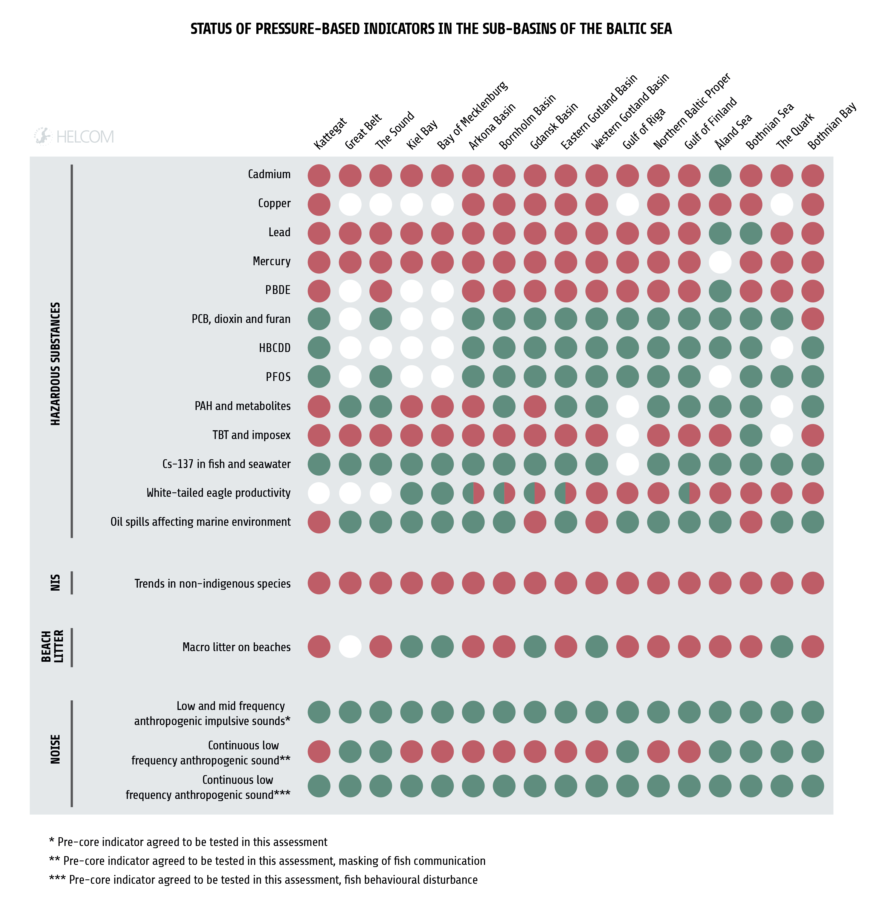
Status of pressure-based core indicators by sub-basin (hazardous substances, NIS, beach litter, noise)
Notes:
Status of pressure-based core indicators for hazardous substances and non-indigenous species, marine litter, underwater noise and eutrophication by sub-basin. For eutrophication the sub-basin Bornholm basin has been separated into Bornholm basin and Pomeranian bay and the sub-basin Gulf of Finland has been separated into Gulf of Finland and Eastern Gulf of Finland. Green circles indicate good status, red circles indicate not good status, and white circles indicate that the core indicator is applicable or relevant to the sub-basin but has not been evaluated. Empty points indicate that the indicator is not applicable or relevant. For coastal indicators, pie charts show proportion of coastal assessment units per sub-basin in good status (green), not good status (red) and not evaluated (white).

Slide 21
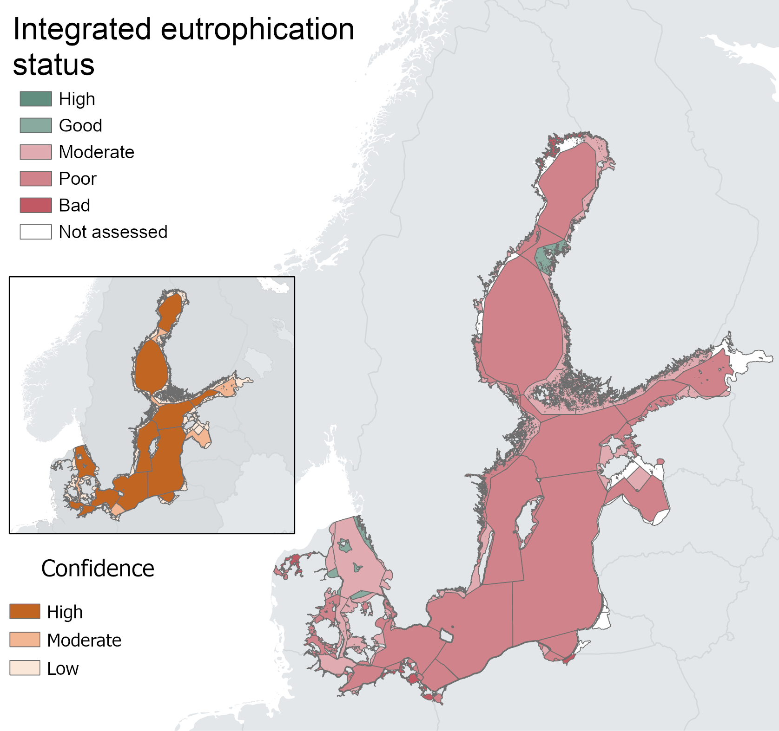
Eutrophication- Key takeaways
Notes:
Eutrophication is still a major problem in the Baltic Sea.
No clear signs of recovery during 2016- 2021 compared to the previous assessment period.
Inputs of nutrients to the Baltic Sea have decreased significantly but the target for maximum allowable inputs has not yet been achieved in all basins.
For the whole Baltic Sea, the normalized total input of nitrogen was reduced by 12% and phosphorus by 28% between the reference period (1997-2003) and 2020.
The maximum allowable input (MAI) target for nitrogen was fulfilled in the Bothnian Bay, Bothnian Sea, Danish Straits and Kattegat.
For the Baltic Proper and the Gulf of Finland, the MAI was exceeded, and results for the Gulf of Riga were statistically uncertain. The target for phosphorus was fulfilled in the Bothnian Bay, Bothnian Sea, Danish Straits and Kattegat. In the remaining sub-basins, the MAI was exceeded also for phosphorus.

Slide 22
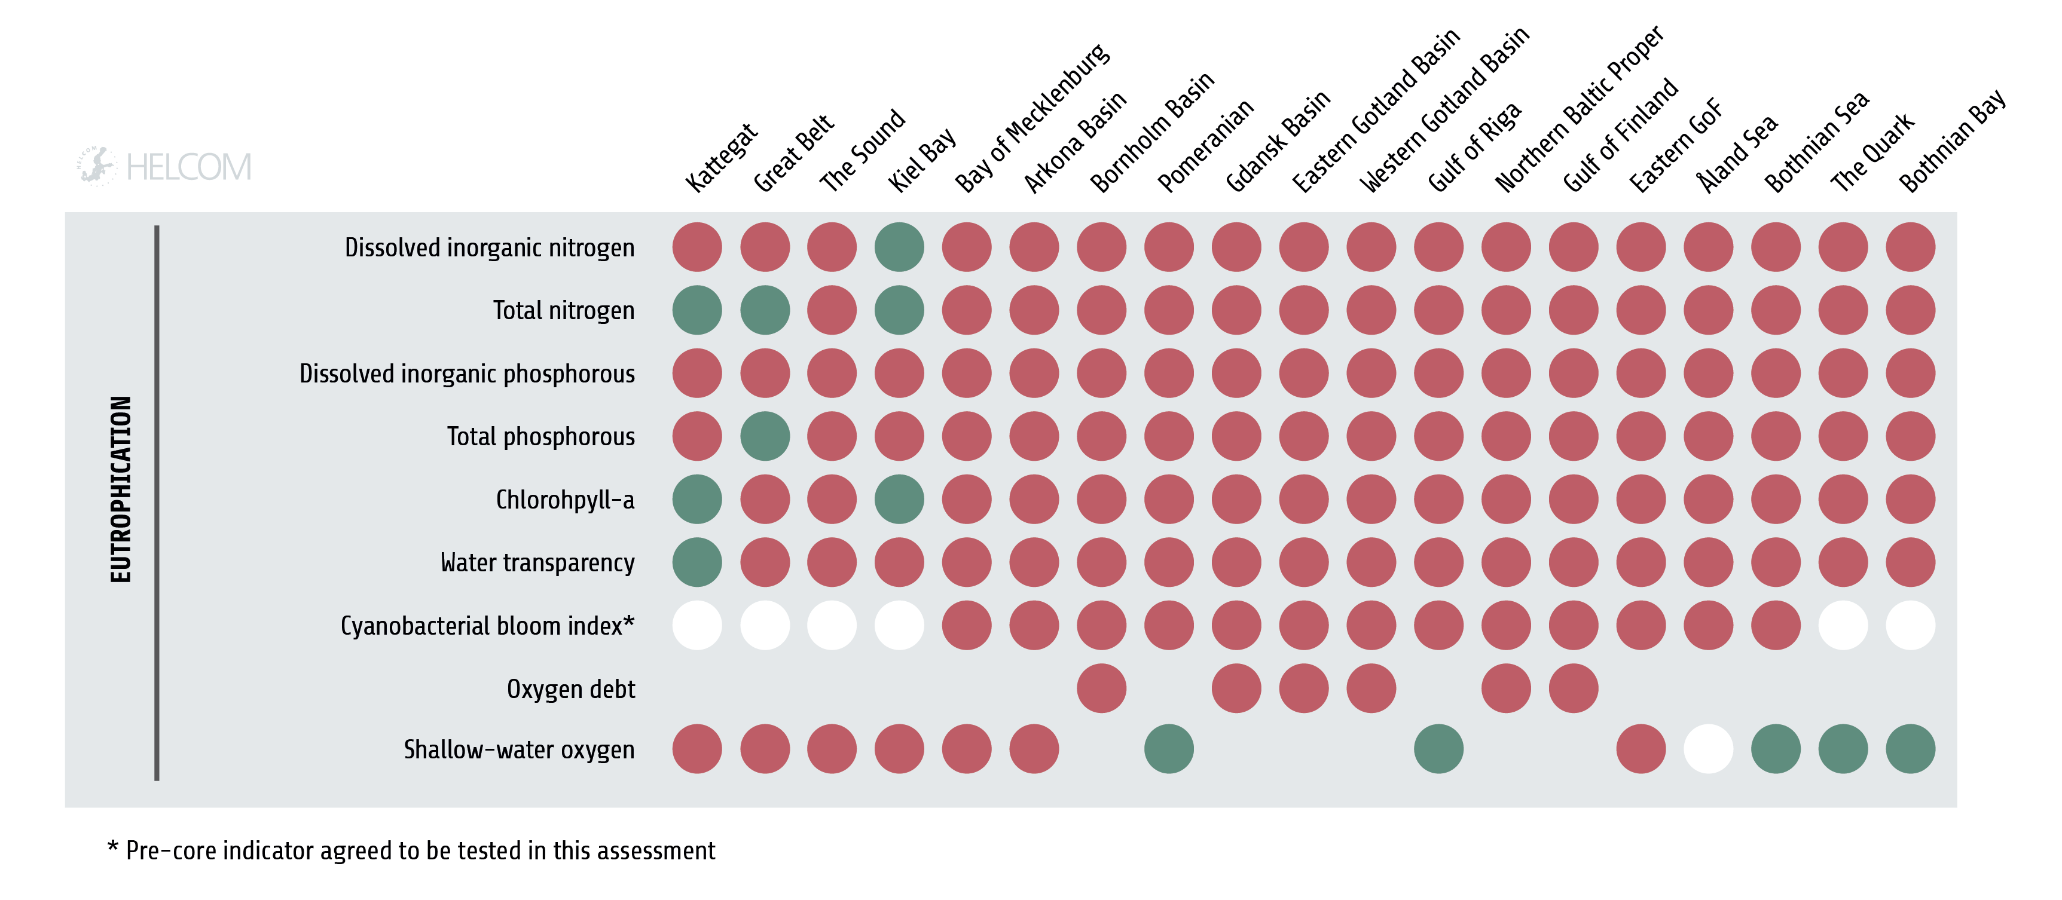
Status of pressure-based core indicators by sub-basin (eutrophication)
Notes:
Status of pressure-based core indicators for hazardous substances and non-indigenous species, marine litter, underwater noise and eutrophication by sub-basin. For eutrophication the sub-basin Bornholm basin has been separated into Bornholm basin and Pomeranian bay and the sub-basin Gulf of Finland has been separated into Gulf of Finland and Eastern Gulf of Finland. Green circles indicate good status, red circles indicate not good status, and white circles indicate that the core indicator is applicable or relevant to the sub-basin but has not been evaluated. Empty points indicate that the indicator is not applicable or relevant. For coastal indicators, pie charts show proportion of coastal assessment units per sub-basin in good status (green), not good status (red) and not evaluated (white).

Slide 23
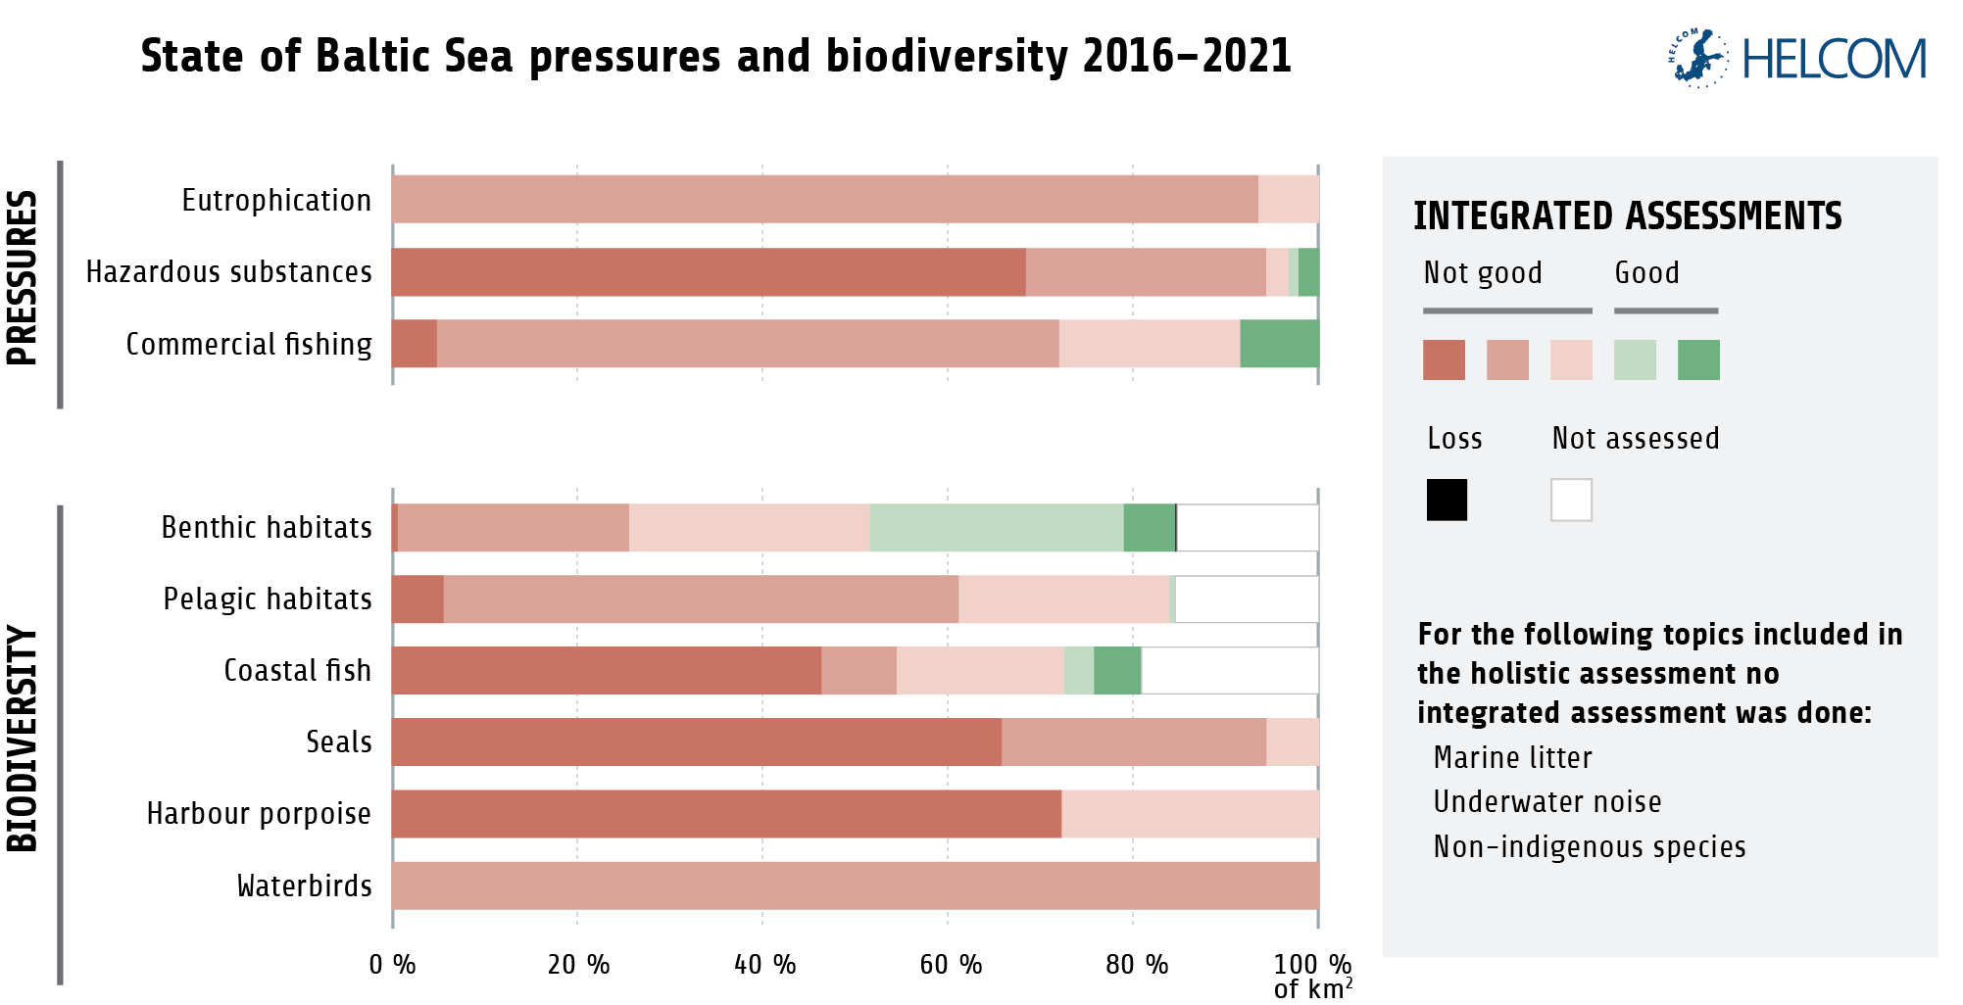
In summary: the state of the Baltic Sea ecosystem has not improved
Notes:
Unfortunately, the results show only little or no improvement in the state of the Baltic Sea environment in 2016-2021.
Indicator-based assessments show cases of poor status in environmental pressures across the full spatial extent of the Baltic Sea.
Across pelagic habitats, benthic habitats, fish, waterbirds and marine mammals, only a few indicators reached their threshold values in parts of the Baltic Sea, and none in all assessed areas.
For some species groups, such as marine mammals and fish, the integrated status has worsened compared to the previous assessment.
Many commercial fish stocks in the Baltic Sea are in an especially poor state.
Figure: Summary of the integrated assessment results of pressures and status for the Baltic Sea showing the proportion of the Baltic Sea in the different assessment status categories (based on square kilometres). Integrated assessment results are shown in five categories with three representing degrees of poor status and two representing degrees of good status, as shown in more detail in the different chapters of the report.

Slide 24
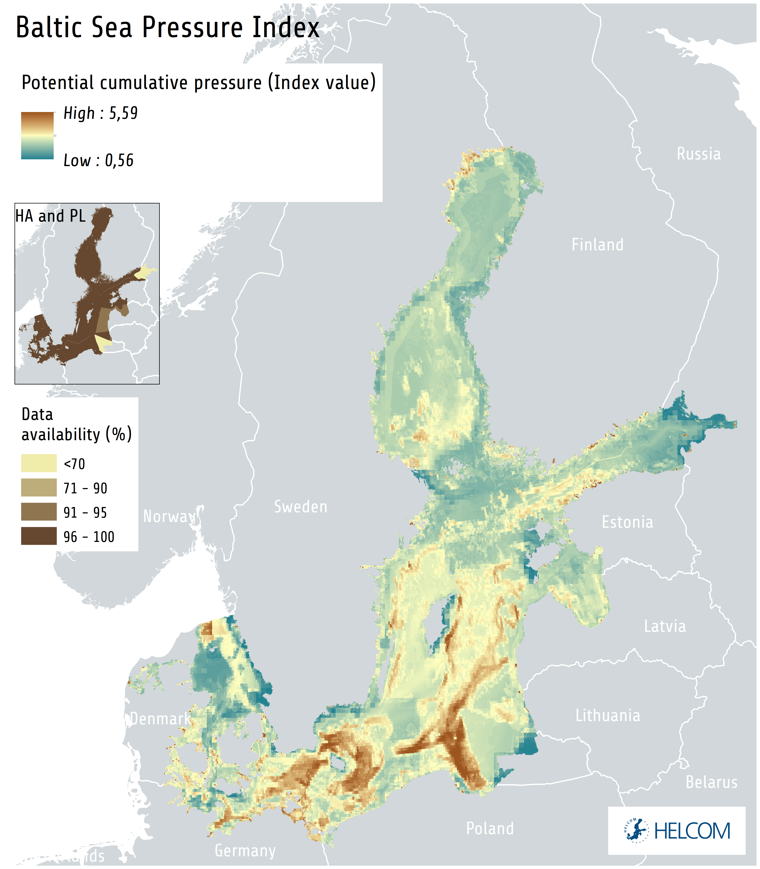
Spatial Distribution of Pressure and Impact Assessment (SPIA)
Notes:
Analyses and links together data on the spatial distribution of species or habitats, human activities and pressures.
An effective tool for exploring how different pressures act on the Baltic Sea ecosystem, where they mainly appear and in which areas different pressures co-occur.
According to these analyses, hazardous substances and eutrophication are the pressures contributing most to the total impact on the Baltic Sea today.
Underwater noise, extraction of fish, and physical disturbance are other widely distributed pressures.
Figure: The Baltic Sea Pressure Index shows the spatial variation in the potential cumulative pressure on the Baltic Sea by combining data on several pressures. The index is based on the currently best available regional data, but spatial gaps may occur in some underlying data sets. The inset data availability map shows data availability for human activities (HA) and pressures (PL).

Slide 25
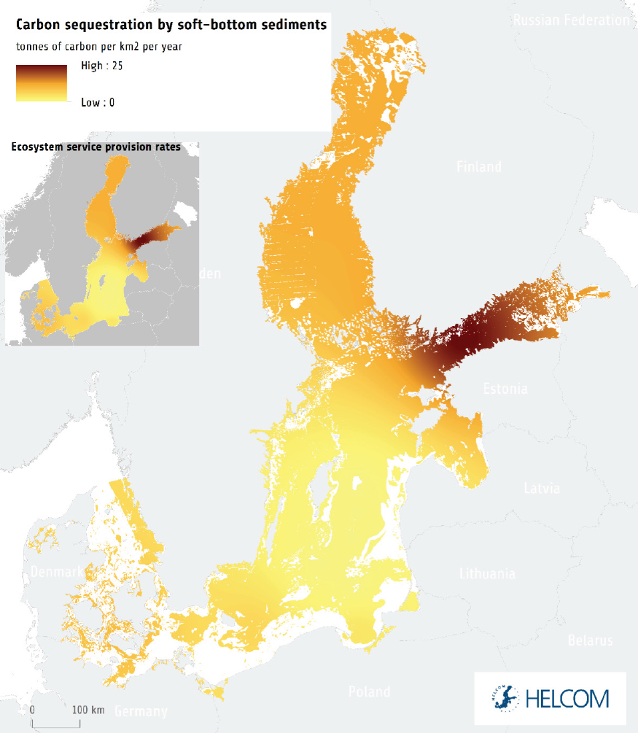
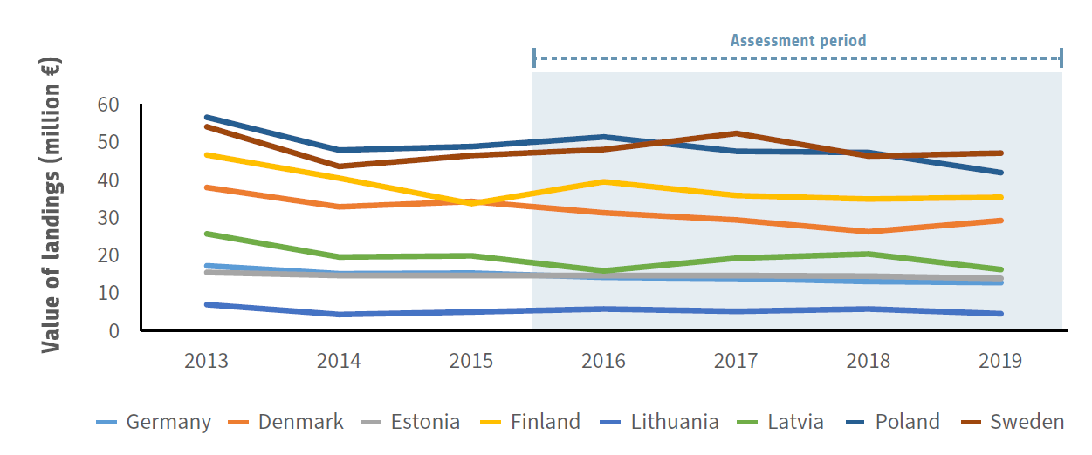
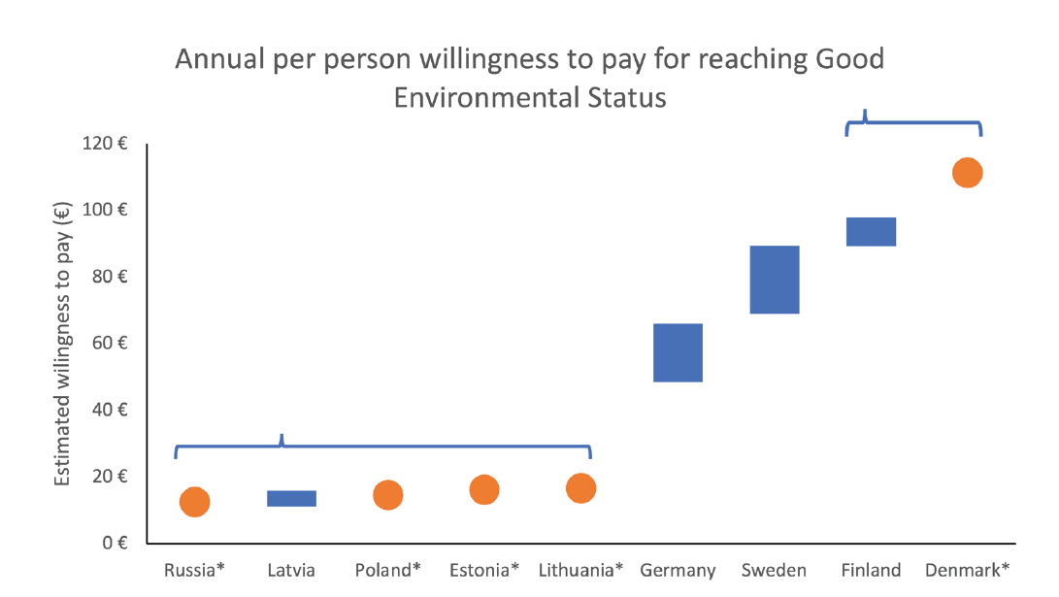
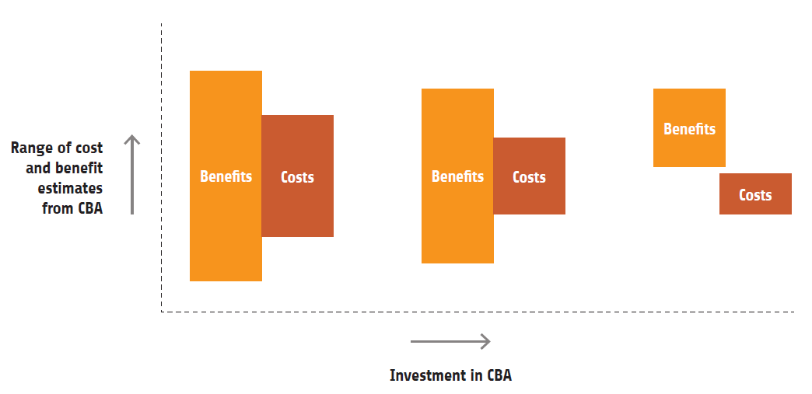
Economic and social analyses
Assessment of ecosystem services
Economic and social analysis of the use of marine waters
Cost of degradation analysis
Cost-benefit analysis
Driver indicator assessments
Notes:
Economic and social analyses play a crucial role in understanding the relationship between the well-being of society and the state of the environment.
The thematic assessment of social and economic analyses covers five types of analyses: Economic and social analysis of the use of marine waters, Cost of degradation, Assessment of ecosystem services, Drivers indicator assessments, Cost-benefit analysis.
The value and potential impact of these analyses depend on the availability of data. Prioritising regional coordination of data generation and sharing is a must.
It is important to recognize that economic and social factors already have an impact on the management of the Baltic Sea, and their importance is likely to continue growing in the future.

Slide 26
Next steps

Slide 27





Key takeaways from HOLAS 3
The Baltic Sea is under increasing impacts from climate change and biodiversity degradation catalysed by eutrophication, pollution, land use and resource extraction.
Little to no improvement of the Baltic Sea environment occurred during the assessment period.
Measures to reduce pressures on the Baltic Sea are working, when they are implemented, and the agreements in the updated Baltic Sea Action Plan remain highly relevant.
The effects of climate change are expected to increase in the future, increasing the need for measures to enhance ecosystem resilience and mitigate their negative impacts.
Transformative changes are needed in all socioeconomic sectors interacting with or affecting the Baltic Sea environment. Actions are needed both to stop current negative trends and to protect and restore ecosystems.
Ecosystem knowledge and policies for the Baltic Sea environment have developed substantially within the past six years.
Implementing the updated BSAP, facilitating ecosystem-based management and minimizing impacts from climate change are focal areas for HELCOM in the coming years.

Slide 28
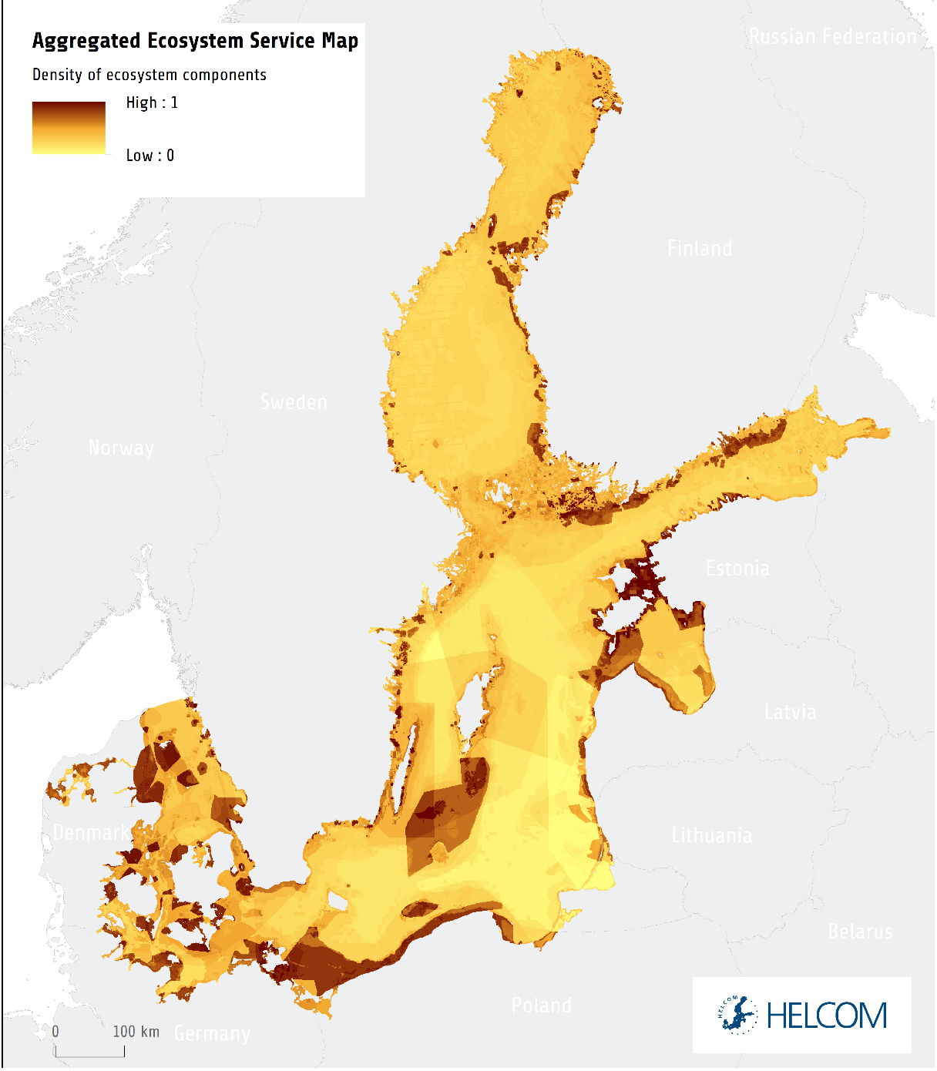
High cost of inaction
Notes:
This deterioration also impacts ecosystem functions that are of central importance for humans.
The poor environmental status of the Baltic Sea clearly affects the profitability of fisheries and tourism, and it also impacts a wide range of ecosystem services on which we depend.
*Degraded environmental conditions are estimated to cost the region’s population 9 billion € annually in terms of forgone recreational benefits.
This estimate is based on individual forgone benefit estimates, ranging from 33€ (Russia) to 206€ (Denmark) per person per year.
Figure 5.5. Illustration of areas with high potential to contribute to ecosystem services in the Baltic Sea. The map is made from 54 different ecosystem component layers based on their respective contribution to specific ecosystem services. For a more detailed description of the data and analyses, see HELCOM (2013d-e) and Ruskule et al. (2023).
Considering the high costs of inaction, achieving a healthy Baltic Sea is also an investment in the sustainable economic and societal development of our region.
Achieving good environmental status in national marine waters by 2040 has been estimated to be worth 5.6 billion € per year to the people around the Baltic Sea.
Jannica to add something about the two maps comparison

Slide 29
High cost of inaction
Notes:
This deterioration also impacts ecosystem functions that are of central importance for humans.
The poor environmental status of the Baltic Sea clearly affects the profitability of fisheries and tourism, and it also impacts a wide range of ecosystem services on which we depend.
Degraded environmental conditions are estimated to cost the region’s population 9 billion € annually in terms of forgone recreational benefits.
Considering the high costs of inaction, achieving a healthy Baltic Sea is also an investment in the sustainable economic and societal development of our region.
Achieving good environmental status in national marine waters by 2040 has been estimated to be worth 5.6 billion € per year to the people around the Baltic Sea.
Jannica to add something about the two maps

Slide 30
High cost of inaction
e.g. 9 billion euro/year lost solely for recreation
Notes:
This deterioration also impacts ecosystem functions that are of central importance for humans.
The poor environmental status of the Baltic Sea clearly affects the profitability of fisheries and tourism, and it also impacts a wide range of ecosystem services on which we depend.
Degraded environmental conditions are estimated to cost the region’s population 9 billion € annually in terms of forgone recreational benefits.
Considering the high costs of inaction, achieving a healthy Baltic Sea is also an investment in the sustainable economic and societal development of our region.
Achieving good environmental status in national marine waters by 2040 has been estimated to be worth 5.6 billion € per year to the people around the Baltic Sea.
Jannica to add something about the two maps

Slide 31
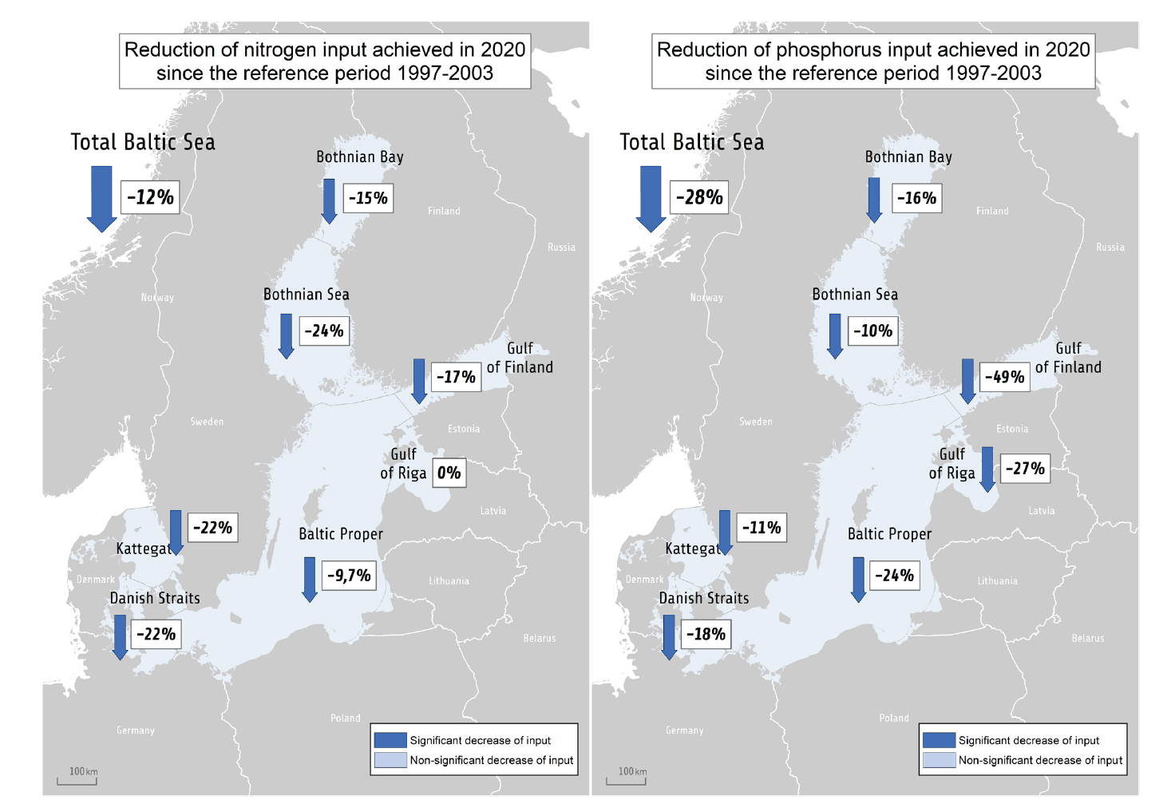
Regional measures are working
Notes:
Measures to reduce pressures on the Baltic marine environment are working, when they are implemented.
As a result of regional agreements, inputs of nutrients have reached sustainable levels in some parts of the Baltic Sea, and so have levels of some hazardous substances that were previously problematic.
Actions for biodiversity conservation have also increased, and the Baltic Sea region is on track to reach the global target of 30% protected area by the year 2030. Such coordinated measures are essential to enable the recovery of the Baltic ecosystem over time. These are fundamental steps and necessary actions, and it is imperative that we build on them further.

Slide 32






Now that we know, where do we go?
National work in HELCOM countries is at the core of implementing the Baltic Sea Action Plan and improving the health of the Baltic Sea.
The third HELCOM holistic assessment highlights the importance of measures to strengthen Baltic Sea biodiversity.
Achieving a healthy Baltic Sea ecosystem requires measures both to limit the extent and intensity of current human-induced pressures and to protect and restore species and habitats.
An urgent need is to equip our shared Baltic Sea ecosystem with the capacity to withstand the future effects of climate change.
A central task for HELCOM is to incorporate current knowledge developments in an ecosystem-based management framework that promotes the sustainability of the Baltic Sea region through cooperation at national, regional, and global levels.
Notes:
National work in HELCOM countries is at the core of implementing the Baltic Sea Action Plan and improving the health of the Baltic Sea.
Achieving a healthy Baltic Sea ecosystem requires measures both to limit the extent and intensity of current human-induced pressures and to protect and restore species and habitats.
An urgent need is to equip our shared Baltic Sea ecosystem with the capacity to withstand the future effects of climate change.
A central task for HELCOM is to incorporate current knowledge developments in an ecosystem-based management framework that supports, and is supported by, national, regional and global actions that enable a sustainable future for the Baltic Sea region.

Slide 33
Thank you!
https://stateofthebalticsea.helcom.fi

